Slide 1

Spark Essentials
Wifi
SSID:
Pass:
Please open this in your browser: http://tinyurl.com/Spark-Essentials-TE2
Jacob Parr, Zoltan C. Toth
Spark Summit West, 4 June 2016.

Slide 2
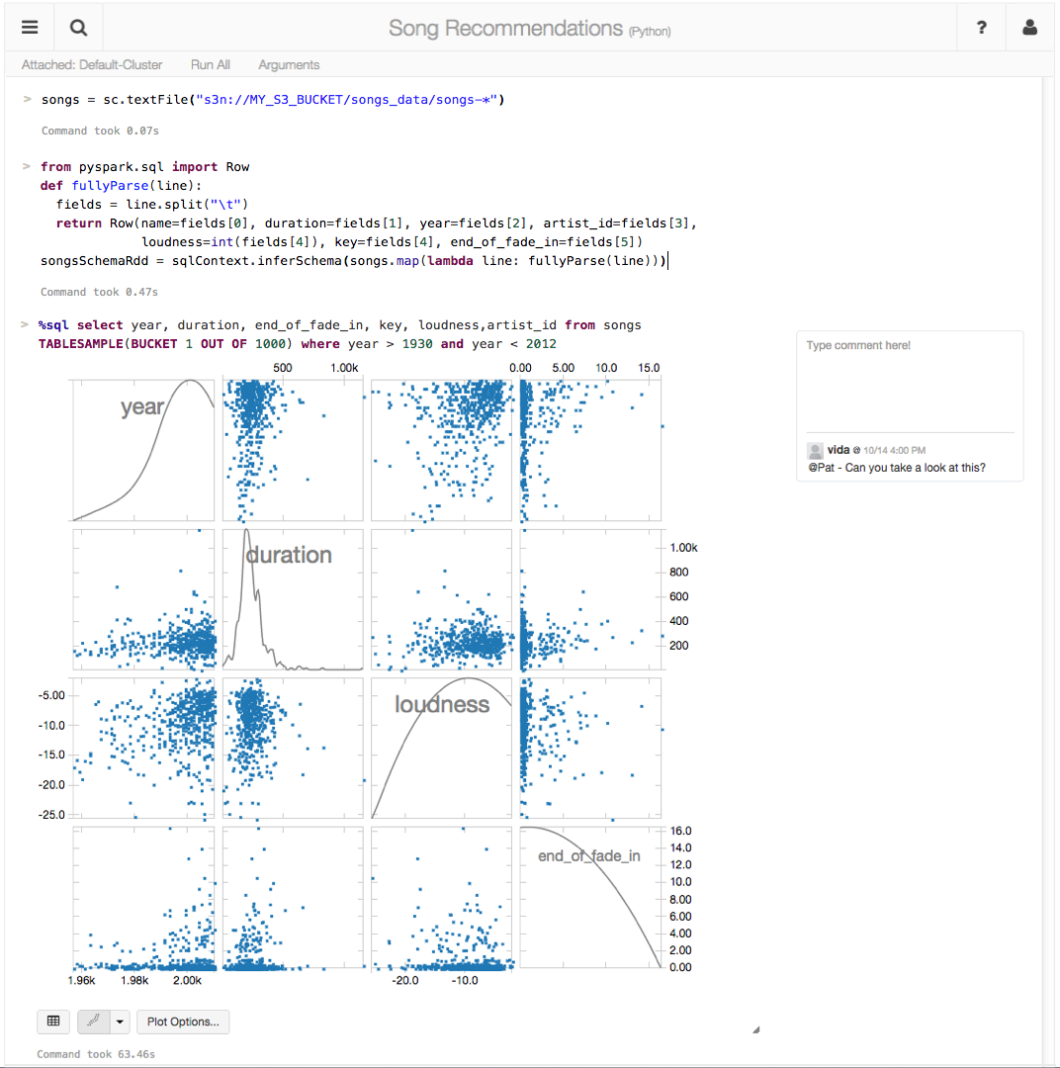
making big data simple
Founded in late 2013
by the creators of Apache Spark
Original team from UC Berkeley AMPLab
Raised $47 Million in 2 rounds
~60 employees
We’re hiring!
Level 2/3 support partnerships with
Hortonworks
MapR
DataStax
(http://databricks.workable.com)
Databricks Cloud:
“A unified platform for building Big Data pipelines – from ETL to Exploration and Dashboards, to Advanced Analytics and Data Products.”
Notes:
Databricks is a company that was founded by the creators of the Spark project in 2013.
And one of the first things the founders did after starting the company was donating Spark to the Apache Software Foundation and they remain the largest contributor to Spark’s code base.
Databricks Cloud is a end-to-end hosted service. The goal of our product is to be the easiest place to be up and running with Spark with little or no up-front hardware or cost investment, since it’s a cloud service. We want to help our customers quickly pull out insights via visualization from your data… without worrying about the intricacies of installing and configuring large Hadoop cluster.

Slide 3
The Databricks team contributed more than 75% of the code added to Spark in the past year
Notes:
The point: Adopting Spark is relatively safe, since it's being maintained by people who are paid to do so.

Slide 4





Instructor: Zoltan C. Toth
LinkedIn: https://www.linkedin.com/in/zoltanctoth
Email: zoltan@datapao.com
Bio: I’m an independent consultant / trainer
Earlier:
Data Engineer @

Slide 5


Teaching Assistants
Ganesh Chand
LinkedIn: https://www.linkedin.com/in/chandganesh
Taggart McCurdy
LinkedIn: https://www.linkedin.com/in/taggart-mccurdy-8766b14

Slide 6
Further info and Q&A
http://tinyurl.com/Spark-Essentials-TE2

Slide 7
Course Objectives
Describe the motivation and fundamental mechanics of Spark
Use the core Spark APIs to operate on real data
Experiment with use cases for Spark
Build data pipelines using Spark SQL and DataFrames
Analyze Spark jobs using the administration UIs and logs
Create Streaming and Machine Learning jobs using the common Spark API

Slide 8
Schedule
9:00-10:30 Spark overview, RDD API 10:30 – 10:45 break
10:45-12:00 DataFrames and SQL API
12:00-13:00 Lunch
13:00-14:00 DataFrames and SQL API 14:00 – 10:15 break
14:15-15:45 Spark Internals and Streaming 15:45 – 16:00 break
16:00-17:00 Machine Learning

Slide 9
Files and Resources
Documents, Slides and other files: On your USB stick
Databricks URL:
http://ssw2016.cloud.databricks.com
Your username and password are on the slips of paper handed to each of you.
NOTE: Use Chrome or Firefox
Internet Explorer is not supported
Safari may or may not work.

Slide 10
Notebook Hands on
Take a minute to log into your Databricks account and find your home directory.
Then, let me show you how to create a notebook and how we'll be using the labs.
After that, I'll give you a few minutes to create your own notebook and play around.

Slide 11
Overview

Slide 12
Started as a research project at UC Berkeley in 2009
Open Source License (Apache 2.0)
Latest Stable Release: v1.6.1 (March 2016)
600,000 lines of code (75% Scala)
Built by 800+ developers from 200+ companies

Slide 13


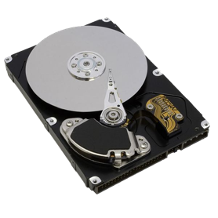

0.1 Gb/s
1 Gb/s or 125 MB/s
Nodes in another rack
CPUs:
Network
10 GB/s
1 Gb/s or 125 MB/s
Nodes in same rack
100 MB/s
600 MB/s
3-12 ms random access
$0.05 per GB
0.1 ms random access
$0.45 per GB

Slide 14

Opportunity
Keep more data in-memory
New distributed execution environment
Bindings for:
Python, Java, Scala, R
Spark SQL
ML/MLLib (machine learning)
GraphX (graph)
Spark Streaming
Apache Spark
http://people.csail.mit.edu/matei/papers/2010/hotcloud_spark.pdf

Slide 15
Use Memory Instead of Disk
HDFS read
HDFS write
HDFS read
HDFS write
iteration 1
iteration 2
. . .
Input
HDFS read
query 1
result 1
query 2
result 2
query 3
result 3
Input
. . .
Notes:
Top: Each iteration is, for example, a MapReduce job.
Bottom: If you want to run multiple queries, each one is a read

Slide 16
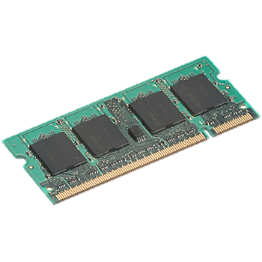
In-Memory Data Sharing
HDFS read
iteration 1
iteration 2
. . .
Input
query 1
result 1
one-time
processing
query 2
result 2
query 3
result 3
Input
Distributed memory
. . .
10-100x faster than network and disk

Slide 17
Goal: unified engine across data ,
Environments
Workloads
sources
workloads
and
environments
Data Sources
Notes:
To-do: build with animations

Slide 18
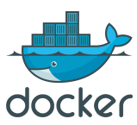

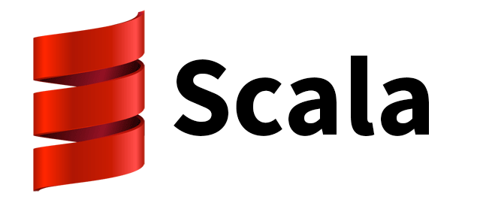
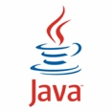
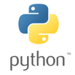





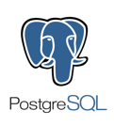

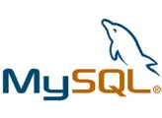




Environments
YARN
Workloads
DataFrames API and Spark SQL
Spark Streaming
MLlib
GraphX
RDD API
Spark Core
{JSON}
Data Sources
Notes:
TO-DO: Add: Environments: OpenStack, Kubernetes. Add Kafka to Data Sources.
Say: Most new code activity is in the higher level libraries. Spark SQL and MLlib’s code base has doubled in the past year.
“for relational databases, there is a JDBC + ODBC connector”
To-do, 2nd iteration + book: Add new rectangle for ‘Notebooks’: Jupiter, Databricks, iPython, Zeplin, etc

Slide 19
End of Spark Overview

Slide 20
RDD Fundamentals

Slide 21
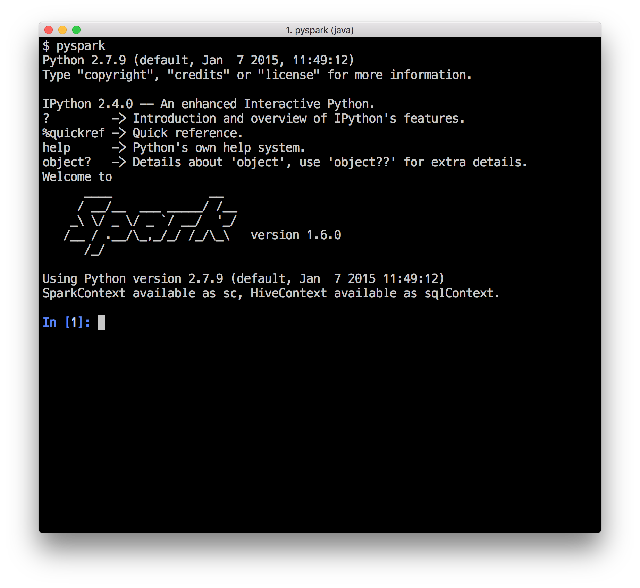
Interactive Shell
(Scala, Python and R only)

Slide 22
W
Ex
RDD
T
Driver Program
RDD
T
Worker Machine
W
Ex
RDD
T
RDD
T
Worker Machine
Notes:
When you start a driver program, it connects to the Spark Cluster
You can make the Driver HA in standalone by setting the Boolean for –supervise to true when using Spark Submit (https://github.com/apache/spark/search?utf8=%E2%9C%93&q=supervise)
In YARN the driver is HA via YARN primitives

Slide 23
Resilient Distributed Datasets (RDDs)
Write programs in terms of operations on distributed datasets
Partitioned collections of objects spread across a cluster, stored in memory or on disk
RDDs built and manipulated through a diverse set of parallel transformations (map, filter, join) and actions (count, collect, save)
RDDs automatically rebuilt on machine failure

Slide 24
more partitions = more parallelism
RDD
item-1
item-2
item-3
item-4
item-5
item-6
item-7
item-8
item-9
item-10
item-11
item-12
item-13
item-14
item-15
item-16
item-17
item-18
item-19
item-20
item-21
item-22
item-23
item-24
item-25
W
W
W
Ex
Ex
Ex
RDD
RDD
RDD
RDD
RDD
Notes:
This RDD has 5 partitions.
An RDD is simply a distributed collection of elements. You can think of the distributed collections like of like an array or list in your single machine program, except that it’s spread out across multiple nodes in the cluster.
In Spark all work is expressed as either creating new RDDs, transforming existing RDDs, or calling operations on RDDs to compute a result. Under the hood, Spark automatically distributes the data contained in RDDs across your cluster and parallelizes the operations you perform on them.
So, Spark gives you APIs and functions that lets you do something on the whole collection in parallel using all the nodes.

Slide 25
RDD w/ 4 partitions
Error, ts, msg1
Warn, ts, msg2
Error, ts, msg1
Info, ts, msg8
Warn, ts, msg2
Info, ts, msg8
Error, ts, msg3
Info, ts, msg5
Info, ts, msg5
Error, ts, msg4
Warn, ts, msg9
Error, ts, msg1
logLinesRDD
A base RDD can be created 2 ways:
- Parallelize a collection
- Read data from an external source (S3, C*, HDFS, etc)

Slide 26


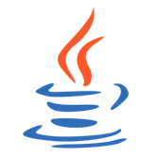
Read from Text File
There are other methods to read data from HDFS, C*, S3, HBase, etc.
// Read a local txt file in Scala
val linesRDD = sc.textFile("/path/to/README.md")
# Read a local txt file in Python
linesRDD = sc.textFile("/path/to/README.md")
// Read a local txt file in Java
JavaRDD<String> lines = sc.textFile("/path/to/README.md");

Slide 27
Parallelize
// Parallelize in Scala
val wordsRDD = sc.parallelize(List("fish", "cats", "dogs"))
Take an existing in-memory collection and pass it to SparkContext’s parallelize method
Not generally used outside of prototyping and testing since it requires entire dataset in memory on one machine
# Parallelize in Python
wordsRDD = sc.parallelize(["fish", "cats", "dogs"])
// Parallelize in Java
JavaRDD<String> wordsRDD = sc.parallelize(Arrays.asList("fish", "cats", "dogs"));
Notes:
In some edge cases this could be useful … e.g., parallelize and partition a set of URLs or metadata, then fetch the actual data on the workers

Slide 28
Operations on Distributed Data
Two types of operations: transformations and actions
Transformations are lazy (not computed immediately)
Transformations are executed when an action is run
Persist (cache) distributed data in memory or disk

Slide 29



Error, ts, msg1
Warn, ts, msg2
Error, ts, msg1
Info, ts, msg8
Warn, ts, msg2
Info, ts, msg8
Error, ts, msg3
Info, ts, msg5
Info, ts, msg5
Error, ts, msg4
Warn, ts, msg9
Error, ts, msg1
logLinesRDD
(input/base RDD)
λ
.filter( )
Error, ts, msg1
Error, ts, msg1
Error, ts, msg3
Error, ts, msg4
Error, ts, msg1
errorsRDD
Notes:
Those are 4 green unique blocks in a single HDFS file
Here we are filtering out the warnings and info messages so we are left with just errors in the RDD.
This doesn’t actually read the file from HDFS just yet… we’re just building out a lineage graph
Initial partition generally determined by SOURCE, which is also aware of location info (e.g., HDFS blocks) and can provide that downstream (via preferredLocations)

Slide 30

Error, ts, msg1
Error, ts, msg1
Error, ts, msg3
Error, ts, msg4
Error, ts, msg1
errorsRDD
.coalesce( 2 )
Error, ts, msg1
Error, ts, msg3
Error, ts, msg1
Error, ts, msg4
Error, ts, msg1
cleanedRDD
.collect( )
Driver

Slide 31
Execute!
.collect( )
Driver
Notes:
The Batman slide

Slide 32

Logical
logLinesRDD
λ
.filter( )
errorsRDD
.coalesce( 2 )
cleanedRDD
.collect( )
Driver

Slide 33
Physical
4. compute
logLinesRDD
3. compute
errorsRDD
2. compute
cleanedRDD
1. compute
Driver

Slide 34
data
data
Driver

Slide 35

logLinesRDD
errorsRDD
.saveAsTextFile( )
Error, ts, msg1
Error, ts, msg3
Error, ts, msg1
Error, ts, msg4
Error, ts, msg1
cleanedRDD
λ
.filter( )
Error, ts, msg1
Error, ts, msg1
Error, ts, msg1
.count( )
5
errorMsg1RDD
.collect( )
Notes:
What if we want to do other things, multiple things, with the cleaned RDD? …

Slide 36


logLinesRDD
errorsRDD
.cache( )
.saveAsTextFile( )
Error, ts, msg1
Error, ts, msg3
Error, ts, msg1
Error, ts, msg4
Error, ts, msg1
cleanedRDD
λ
.filter( )
Error, ts, msg1
Error, ts, msg1
Error, ts, msg1
.count( )
5
errorMsg1RDD
.collect( )
Notes:
It’s okay if only part of the RDD actually fits in memory
Talk about lineage: parent RDD and child RDD

Slide 37

Partition >>> Task >>> Partition
logLinesRDD
(HadoopRDD)
Task-1
Task-2
λ
Task-3
.filter( )
Task-4
errorsRDD
(filteredRDD)
Notes:
This is a narrow transformation…
1 Task <-> 1 Partition, and usually <-> 1 Core (although this can be configured higher)
How many executors? Depends on cluster config. I.e., these 1:1 mappings are NOT 1:1 with executors

Slide 38
Lifecycle of a Spark Program
Create some input RDDs from external data or parallelize a collection in your driver program.
Lazily transform them to define new RDDs using transformations like filter() or map()
Ask Spark to cache() any intermediate RDDs that will need to be reused.
Launch actions such as count() and collect() to kick off a parallel computation, which is then optimized and executed by Spark.

Slide 39
Transformations (lazy)
map() | intersection() | cartesian()
flatMap() | distinct() | pipe()
filter() | groupByKey() | coalesce()
mapPartitions() | reduceByKey() | repartition()
mapPartitionsWithIndex() | sortByKey() | partitionBy()
sample() | join() | ...
union() | cogroup() | ...

Slide 40
Actions
reduce() | takeOrdered()
collect() | saveAsTextFile()
count() | saveAsSequenceFile()
first() | saveAsObjectFile()
take() | countByKey()
takeSample() | foreach()
saveToCassandra() | ...
Notes:
Actions force the evaluation of the transformations required for the RDD they are called on, since they are required to actually produce output.

Slide 41
Some Types of RDDs
HadoopRDD
FilteredRDD
MappedRDD
PairRDD
ShuffledRDD
UnionRDD
PythonRDD
DoubleRDD
JdbcRDD
JsonRDD
VertexRDD
EdgeRDD
CassandraRDD (DataStax)
GeoRDD (ESRI)
EsSpark (ElasticSearch)
Notes:
There are various types of RDDs, and you can write your own.

Slide 42
Hands-on with RDDs
In the Databricks shard, look in
Workspace > Labs > Essential > RDD-Fundamentals
In there, you'll find a Washington-Crime folder, with Python and Scala folders beneath it.
Open the lab notebook
Attach the lab notebook to your cluster
Follow the instructions in the notebook
Stop when you get to the section entitled "Demonstration".
If you have trouble with any of the exercises, consulting the appropriate Solutions notebook.

Slide 43
End of RDD Fundamentals

Slide 44
Intro to DataFrames and Spark SQL

Slide 45
Spark SQL
Part of the core distribution since 1.0 (April 2014)
Runs SQL / HiveQL queries, optionally alongside or replacing existing Hive deployments
Improved multi-version support in 1.4

Slide 46
DataFrames API - motivation
Enable wider audiences beyond “Big Data” engineers to leverage the power of distributed processing
Inspired by data frames in R and Python (Pandas)
Designed from the ground-up to support modern big data and data science applications
Extension to the existing RDD API
See
https://spark.apache.org/docs/latest/sql-programming-guide.html
databricks.com/blog/2015/02/17/introducing-dataframes-in-spark-for-large-scale-data-science.html

Slide 47
DataFrames
The preferred abstraction in Spark (introduced in 1.3)
Strongly typed collection of distributed elements
Built on Resilient Distributed Datasets
Immutable once constructed
Track lineage information to efficiently recompute lost data
Enable operations on collection of elements in parallel
You construct DataFrames
by parallelizing existing collections (e.g., Pandas DataFrames)
by transforming an existing DataFrames
from files in HDFS or any other storage system (e.g., Parquet)

Slide 48
DataFrames Features
Ability to scale from kilobytes of data on a single laptop to petabytes on a large cluster
Support for a wide array of data formats and storage systems
State-of-the-art optimization and code generation through the Spark SQL Catalyst optimizer
Seamless integration with all big data tooling and infrastructure via Spark
APIs for Python, Java, Scala, and R

Slide 49
DataFrames versus RDDs
Familiar For new users familiar with data frames in other programming languages, this API should make them feel at home
Easy For existing Spark users, the API will make Spark easier to program than using RDDs
Optimized For both sets of users, DataFrames will improve performance through intelligent optimizations and code-generation

Slide 50

Write Less Code: Input & Output
Unified interface to reading/writing data in a variety of formats.
val df = sqlContext. read. format("json").
option("samplingRatio", "0.1").
load("/Users/spark/data/stuff.json")
df.write.
format("parquet").
mode("append").
partitionBy("year").
saveAsTable("faster-stuff")

Slide 51
Write Less Code: Input & Output
Unified interface to reading/writing data in a variety of formats.
val df = sqlContext. read. format("json").
option("samplingRatio", "0.1").
load("/Users/spark/data/stuff.json")
df.write.
format("parquet").
mode("append").
partitionBy("year").
saveAsTable("faster-stuff")
read and write functions create new builders for doing I/O

Slide 52
Write Less Code: Input & Output
Unified interface to reading/writing data in a variety of formats.
val df = sqlContext. read. format("json").
option("samplingRatio", "0.1").
load("/Users/spark/data/stuff.json")
df.write.
format("parquet").
mode("append").
partitionBy("year").
saveAsTable("faster-stuff")
}
Builder methods
specify:
format
partitioning
handling of existing data
}

Slide 53
Write Less Code: Input & Output
Unified interface to reading/writing data in a variety of formats.
val df = sqlContext. read. format("json").
option("samplingRatio", "0.1").
load("/Users/spark/data/stuff.json")
df.write.
format("parquet").
mode("append").
partitionBy("year").
saveAsTable("faster-stuff")
load(…), save(…), or saveAsTable(…) finish the I/O specification

Slide 54

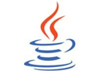




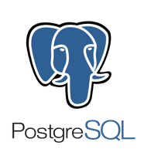






Data Sources supported by DataFrames
built-in
external
JDBC
{ JSON }
and more …
Notes:
C* and memsql have written custom RDDs that use data locality.

Slide 55
Write Less Code: High-Level Operations
Solve common problems concisely with DataFrame functions:
selecting columns and filtering
joining different data sources
aggregation (count, sum, average, etc.)
plotting results (e.g., with Pandas)

Slide 56


Write Less Code: Compute an Average
private IntWritable one = new IntWritable(1);
private IntWritable output = new IntWritable();
protected void map(LongWritable key,
Text value,
Context context) {
String[] fields = value.split("\t");
output.set(Integer.parseInt(fields[1]));
context.write(one, output);
}
----------------------------------------------------------------------------------
IntWritable one = new IntWritable(1)
DoubleWritable average = new DoubleWritable();
protected void reduce(IntWritable key,
Iterable<IntWritable> values,
Context context) {
int sum = 0;
int count = 0;
for (IntWritable value: values) {
sum += value.get();
count++;
}
average.set(sum / (double) count);
context.write(key, average);
}
rdd = sc.textFile(...).map(_.split(" "))
rdd.map { x => (x(0), (x(1).toFloat, 1)) }.
reduceByKey { case ((num1, count1), (num2, count2)) =>
(num1 + num2, count1 + count2)
}.
map { case (key, (num, count)) => (key, num / count) }.
collect()
rdd = sc.textFile(...).map(lambda s: s.split())
rdd.map(lambda x: (x[0], (float(x[1]), 1))).\
reduceByKey(lambda t1, t2: (t1[0] + t2[0], t1[1] + t2[1])).\
map(lambda t: (t[0], t[1][0] / t[1][1])).\
collect()
Notes:
Input file example:
coffee 10
coffee 20
coffee 32
tea 10
tea 5
tea 30

Slide 57

Write Less Code: Compute an Average
Using RDDs
Full API Docs
Scala
Java
Python
R
rdd = sc.textFile(...).map(_.split(" "))
rdd.map { x => (x(0), (x(1).toFloat, 1)) }.
reduceByKey { case ((num1, count1), (num2, count2)) =>
(num1 + num2, count1 + count2)
}.
map { case (key, (num, count)) => (key, num / count) }.
collect()
Using DataFrames
import org.apache.spark.sql.functions._
val df = rdd.map(a => (a(0), a(1))).toDF("key", "value")
df.groupBy("key")
.agg(avg("value"))
.collect()

Slide 58
Hands on
Let's take a quick look at that in action. Under
Workspace > Labs > sql-and-dataframes
you'll find a less-code folder. In that folder, you'll find a Python notebook and a Scala notebook. Attach it to your cluster, and follow along.

Slide 59

Construct a DataFrame (Scala)
# Construct a DataFrame from a "users" table in Hive.
val df = sqlContext.table("users")
# Construct a DataFrame from a log file in S3.
val df = sqlContext.load("s3n://aBucket/path/to/data.json", "json")
Notes:
The following example shows how to construct DataFrames in Python. A similar API is available in Scala and Java.

Slide 60
Construct a DataFrame (Python)
# Construct a DataFrame from a "users" table in Hive.
df = sqlContext.table("users")
# Construct a DataFrame from a log file in S3.
df = sqlContext.load.json("s3n://aBucket/path/to/data.json")
Notes:
The following example shows how to construct DataFrames in Python. A similar API is available in Scala and Java.

Slide 61
Use DataFrames (Scala)
// Create a new DataFrame that contains only "young" users
val young = users.filter($"age" < 21)
// Increment everybody's age by 1
young.select($"name", $"age" + 1)
// Count the number of young users by gender
young.groupBy("gender").count()
# Join young users with another DataFrame, logs
young.join(log, logs("userId") === users("userId"), "left_outer")
Notes:
Once built, DataFrames provide a domain-specific language for distributed data manipulation. Here is an example of using DataFrames to manipulate the demographic data of a large population of users:

Slide 62
Use DataFrames (Python)
# Create a new DataFrame that contains only "young" users
young = users.filter(users["age"] < 21)
# Alternatively, using a Pandas-like syntax
young = users[users.age < 21]
# Increment everybody's age by 1
young.select(young["name"], young["age"] + 1)
# Count the number of young users by gender
young.groupBy("gender").count()
# Join young users with another DataFrame, logs
young.join(log, logs["userId"] == users["userId"], "left_outer")
Notes:
Once built, DataFrames provide a domain-specific language for distributed data manipulation. Here is an example of using DataFrames to manipulate the demographic data of a large population of users:

Slide 63
DataFrames and Spark SQL
young.registerTempTable("young")
sqlContext.sql("SELECT count(*) FROM young")
Notes:
You can also incorporate SQL while working with DataFrames, using Spark SQL. This example counts the number of users in the young DataFrame. NOTE: registerTempTable does not create a table, temporary or otherwise.

Slide 64
DataFrames and Spark SQL
DataFrames are fundamentally tied to Spark SQL
The DataFrames API provides a programmatic interface—really, a domain-specific language (DSL)—for interacting with your data.
Spark SQL provides a SQL-like interface.
Anything you can do in Spark SQL, you can do in DataFrames
… and vice versa

Slide 65
What, exactly, is Spark SQL?
Spark SQL allows you to manipulate distributed data with SQL queries. Currently, two SQL dialects are supported.
If you’re using a Spark SQLContext, the only supported dialect is “sql,” a rich subset of SQL 92.
If you’re using a HiveContext, the default dialect is "hiveql", corresponding to Hive's SQL dialect. “sql” is also available, but “hiveql” is a richer dialect.

Slide 66
Spark SQL
You issue SQL queries through a SQLContext or HiveContext, using the sql() method.
The sql() method returns a DataFrame.
You can mix DataFrame methods and SQL queries in the same code.
To use SQL, you must either:
query a persisted Hive table, or
make a table alias for a DataFrame, using registerTempTable()

Slide 67
Transformations, Actions, Laziness
Like RDDs, DataFrames are lazy. Transformations contribute to the query plan, but they don't execute anything.
Actions cause the execution of the query.
Transformation examples
Action examples
filter
select
drop
intersect
join
count
collect
show
head
take
Notes:
Head is non-deterministic, could change between jobs. Just the first partition that materialized returns results.

Slide 68
Transformations, Actions, Laziness
Actions cause the execution of the query.
What, exactly, does “execution of the query” mean? It means:
Spark initiates a distributed read of the data source
The data flows through the transformations (the RDDs resulting from the Catalyst query plan)
The result of the action is pulled back into the driver JVM.

Slide 69
Creating a DataFrame
You create a DataFrame with a SQLContext object (or one of its descendants)
In the Spark Scala shell (spark-shell) or pyspark, you have a SQLContext available automatically, as sqlContext.
In an application, you can easily create one yourself, from a SparkContext.
The DataFrame data source API is consistent, across data formats.
“Opening” a data source works pretty much the same way, no matter what.
Notes:
.. Or a HiveContext

Slide 70
Creating a DataFrame in Scala
Program: including setup; the DataFrame reads are 1 line each
import org.apache.spark.{SparkConf, SparkContext}
import org.apache.spark.sql.SQLContext
val conf = new SparkConf().setAppName(appName).
setMaster(master)
// Returns existing SparkContext, if there is one;
// otherwise, creates a new one from the config.
val sc = SparkContext.getOrCreate(conf)
// Ditto.
val sqlContext = SQLContext.getOrCreate(sc)
val df = sqlContext.read.parquet("/path/to/data.parquet")
val df2 = sqlContext.read.json("/path/to/data.json")

Slide 71
Creating a DataFrame in Python
Program: including setup; the DataFrame reads are 1 line each
# The import isn't necessary in the SparkShell or Databricks
from pyspark import SparkContext, SparkConf
# The following three lines are not necessary
# in the pyspark shell
conf = SparkConf().setAppName(appName).setMaster(master)
sc = SparkContext(conf=conf)
sqlContext = SQLContext(sc)
df = sqlContext.read.parquet("/path/to/data.parquet")
df2 = sqlContext.read.json("/path/to/data.json")

Slide 72
DataFrames Have Schemas
In the previous example, we created DataFrames from Parquet and JSON data.
A Parquet table has a schema (column names and types) that Spark can use. Parquet also allows Spark to be efficient about how it pares down data.
Spark can infer a Schema from a JSON file.

Slide 73
printSchema()
You can have Spark tell you what it thinks the data schema is, by calling the printSchema() method. (This is mostly useful in the shell.)
> df.printSchema()
root |-- firstName: string (nullable = true) |-- lastName: string (nullable = true) |-- gender: string (nullable = true) |-- age: integer (nullable = false)

Slide 74
Schema Inference
Some data sources (e.g., Parquet) can expose a formal schema; others (e.g., plain text files) don’t. How do we fix that?
You can create an RDD of a particular type and let Spark infer the schema from that type. We’ll see how to do that in a moment.
You can use the API to specify the schema programmatically.
Notes:
Refer people to the Spark Programming Guide (spark.apache.org) for all the gory details.

Slide 75
Schema Inference Example
Suppose you have a (text) file that looks like this:
Erin,Shannon,F,42
Norman,Lockwood,M,81
Miguel,Ruiz,M,64
Rosalita,Ramirez,F,14
Ally,Garcia,F,39
Claire,McBride,F,23
Abigail,Cottrell,F,75 José,Rivera,M,59 Ravi,Dasgupta,M,25 …
The file has no schema, but it’s obvious there is one:
First name: string Last name: string Gender: string Age: integer
Let’s see how to get Spark to infer the schema.

Slide 76

Schema Inference (Scala)
import sqlContext.implicits._
case class Person(firstName: String,
lastName: String,
gender: String,
age: Int)
val rdd = sc.textFile("people.csv")
val peopleRDD = rdd.map { line =>
val cols = line.split(",")
Person(cols(0), cols(1), cols(2), cols(3).toInt)
}
val df = peopleRDD.toDF
// df: DataFrame = [firstName: string, lastName: string, gender: string, age: int]
Notes:
Notice this is problematic, all columns are treated as strings (including age)
You’d want to be more robust about parsing CSV in real life.
The serializer can’t easily infer the types of the columns if you use a Python class. A namedtuple is preferred.

Slide 77
Schema Inference (Python)
from pyspark.sql import Row
rdd = sc.textFile("people.csv")
Person = Row('first_name', 'last_name', 'gender', 'age')
def line_to_person(line):
cells = line.split(",")
cells[3] = int(cells[3])
return Person(*cells)
peopleRDD = rdd.map(line_to_person)
df = peopleRDD.toDF()
# DataFrame[first_name: string, last_name: string, \
# gender: string, age: bigint]
Notes:
This also works in Scala…
Notice this is problematic, all columns are treated as strings (including age)
You’d want to be more robust about parsing CSV in real life.
The serializer can’t easily infer the types of the columns if you use a Python class. A namedtuple is preferred.

Slide 78
Schema Inference
We can also force schema inference
without creating our own Person type,
by using a fixed-length data structure (such as a tuple)
and supplying the column names to the toDF() method.

Slide 79
Schema Inference (Scala)
val rdd = sc.textFile("people.csv")
val peopleRDD = rdd.map { line =>
val cols = line.split(",")
(cols(0), cols(1), cols(2), cols(3).toInt)
}
val df = peopleRDD.toDF("firstName", "lastName",
"gender", "age")
If you don’t supply the column names, the API defaults to “_1”, “_2”, etc.
Notes:
You’d want to be more robust about parsing CSV in real life.

Slide 80
Schema Inference (Python)
rdd = sc.textFile("people.csv")
def line_to_person(line):
cells = line.split(",")
return (cells[0], cells[1], cells[2], int(cells[3]))
peopleRDD = rdd.map(line_to_person)
df = peopleRDD.toDF(['first_name', 'last_name', 'gender', 'age'])
# DataFrame[first_name: string, last_name: string, \
# gender: string, age: bigint]
Notes:
You’d want to be more robust about parsing CSV in real life.
The serializer can’t easily infer the types of the columns if you use a Python class. A namedtuple is preferred.

Slide 81
Schema Inference (Python)
from collections import namedtuple
Person = namedtuple('Person',
['first_name', 'last_name', 'gender', 'age']
)
rdd = sc.textFile("people.csv")
def line_to_person(line):
cells = line.split(",")
return Person(cells[0], cells[1], cells[2], int(cells[3]))
peopleRDD = rdd.map(line_to_person)
df = peopleRDD.toDF()
# DataFrame[first_name: string, last_name: string, \
# gender: string, age: bigint]
Notes:
You’d want to be more robust about parsing CSV in real life.
The serializer can’t easily infer the types of the columns if you use a Python class. A namedtuple is preferred.

Slide 82
Hands-on with DataFrames
In the Databricks shard, look in
Workspace > Labs > sql-and-dataframes
In there, you'll find a hands-on folder, with Python and Scala notebooks beneath it.
Open the notebook
Attach the notebook to your cluster
Follow the instructions in the notebook

Slide 83
What can I do with a DataFrame?
Once you have a DataFrame, there are a number of operations you can perform.
Let’s look at a few of them.
But, first, let’s talk about columns.

Slide 84
Columns
When we say “column” here, what do we mean?
a DataFrame column is an abstraction. It provides a common column-oriented view of the underlying data, regardless of how the data is really organized.
Columns are important because much of the DataFrame API consists of functions that take or return columns (even if they don’t look that way at first).

Slide 85
Columns
Input Source Format | Data Frame Variable Name | Data
JSON | dataFrame1 | [ {"first": "Amy", "last": "Bello", "age": 29 }, {"first": "Ravi", "last": "Agarwal", "age": 33 }, … ]
CSV | dataFrame2 | first,last,age Fred,Hoover,91 Joaquin,Hernandez,24 …
SQL Table | dataFrame3
Let's see how DataFrame columns map onto some common data sources.
first | last | age
Joe | Smith | 42
Jill | Jones | 33

Slide 86
Columns
dataFrame1 column: "first"
Input Source Format | Data Frame Variable Name | Data
JSON | dataFrame1 | [ {"first": "Amy", "last": "Bello", "age": 29 }, {"first": "Ravi", "last": "Agarwal", "age": 33 }, … ]
CSV | dataFrame2 | first,last,age Fred,Hoover,91 Joaquin,Hernandez,24 …
SQL Table | dataFrame3
dataFrame2 column: "first"
dataFrame3 column: "first"
first | last | age
Joe | Smith | 42
Jill | Jones | 33

Slide 87
Columns
Assume we have a DataFrame, df, that reads a data source that has "first", "last", and "age" columns.
Python | Java | Scala | R
df["first"] df.first† | df.col("first") | df("first") $"first"‡ | df$first
†In Python, it’s possible to access a DataFrame’s columns either by attribute (df.age) or by indexing (df['age']). While the former is convenient for interactive data exploration, you should use the index form. It's future proof and won’t break with column names that are also attributes on the DataFrame class.
‡The $ syntax can be ambiguous, if there are multiple DataFrames in the lineage.
Notes:
It is not recommended to use the . dot notation.

Slide 88
show()
You can look at the first n elements in a DataFrame with the show() method. If not specified, n defaults to 20.
This method is an action. It:
reads (or re-reads) the input source
executes the RDD DAG across the cluster
pulls the n elements back to the driver JVM
displays those elements in a tabular form

Slide 89
show()
> df.show()
+---------+--------+------+---+
|firstName|lastName|gender|age|
+---------+--------+------+---+
| Erin| Shannon| F| 42|
| Claire| McBride| F| 23|
| Norman|Lockwood| M| 81|
| Miguel| Ruiz| M| 64|
| Rosalita| Ramirez| F| 14|
| Ally| Garcia| F| 39|
| Abigail|Cottrell| F| 75|
| José| Rivera| M| 59|
+---------+--------+------+---+

Slide 90
select()
select() is like a SQL SELECT, allowing you to limit the results to specific columns.
scala> df.select($"firstName", $"age").show(5)
+---------+---+ |firstName|age| +---------+---+ | Erin| 42| | Claire| 23| | Norman| 81| | Miguel| 64| | Rosalita| 14| +---------+---+
Notes:
Talk about the DSL for accessing columns here.
Parquet would be very good with this sort of slicing.

Slide 91
select()
select() is like a SQL SELECT, allowing you to limit the results to specific columns.
In[1]: df.select(df["first_name"], df["age"], df["age"] > 49).show(5)
+----------+---+----------+
|first_name|age|(age > 49)|
+----------+---+----------+
| Erin| 42| false|
| Claire| 23| false|
| Norman| 81| true|
| Miguel| 64| true|
| Rosalita| 14| false|
+----------+---+----------+

Slide 92
select()
The DSL also allows you create on-the-fly derived columns.
scala> df.select($"firstName", $"age", $"age" > 49, $"age" + 10).show(5)
+---------+---+----------+----------+
|firstName|age|(age > 49)|(age + 10)|
+---------+---+----------+----------+
| Erin| 42| false| 52|
| Claire| 23| false| 33|
| Norman| 81| true| 91|
| Miguel| 64| true| 74|
| Rosalita| 14| false| 24|
+---------+---+----------+----------+
Notes:
We are generating 2 new columns here.

Slide 93
select()
The DSL also allows you create on-the-fly derived columns.
In[1]: df.select(df["firstName"], df["age"], df["age"] > 49, df["age"] + 10).show(5)
+---------+---+----------+----------+
|firstName|age|(age > 49)|(age + 10)|
+---------+---+----------+----------+
| Erin| 42| false| 52|
| Claire| 23| false| 33|
| Norman| 81| true| 91|
| Miguel| 64| true| 74|
| Rosalita| 14| false| 24|
+---------+---+----------+----------+
Notes:
We are generating 2 new columns here.

Slide 94
filter()
The filter() method allows you to filter rows out of your results.
scala> df.filter($"age" > 49). select($"first_name", $"age"). show()
+---------+---+ |firstName|age| +---------+---+ | Norman| 81| | Miguel| 64| | Abigail| 75| +---------+---+

Slide 95
filter()
The filter() method allows you to filter rows out of your results.
In[1]: df.filter(df["age"] > 49).\ select(df["first_name"],
df["age"]).show()
+---------+---+ |firstName|age| +---------+---+ | Norman| 81| | Miguel| 64| | Abigail| 75| +---------+---+

Slide 96
filter()
The filter() method allows you to filter rows out of your results.
scala> df.filter($"age" > 49).select($"firstName", $"age").show()
+---------+---+ |firstName|age| +---------+---+ | Norman| 81| | Miguel| 64| | Abigail| 75| +---------+---+
Notes:
This is like a where clause in SQL…
There are 3 dataframes here.

Slide 97
filter()
The filter() method allows you to filter rows out of your results.
In[1]: df.filter(df["age"] > 49).select(df["firstName"], df["age"]).show()
+---------+---+ |firstName|age| +---------+---+ | Norman| 81| | Miguel| 64| | Abigail| 75| +---------+---+
Notes:
This is like a where clause in SQL…
There are 3 dataframes here.

Slide 98
Hands-on with DataFrames
In the Databricks shard, look in
Workspace > Labs > sql-and-dataframes
In there, you'll find a hands-on folder, with Python and Scala notebooks beneath it.
Open the notebook
Attach the notebook to your cluster
Follow the instructions in the notebook

Slide 99
orderBy()
The orderBy() method allows you to sort the results.
scala> df.filter($"age" > 49). select($"firstName", $"age"). orderBy($"age", $"firstName"). show()
+---------+---+ |firstName|age| +---------+---+ | Miguel| 64| | Abigail| 75| | Norman| 81| +---------+---+
Notes:
This sorts first my age, then by name.
(if there were a couple of people aged 75, you could see this better)

Slide 100
orderBy()
The orderBy() method allows you to sort the results.
In[1]: df.filter(df["age”] > 49).\ select(df["firstName”], df["age”]).\ orderBy(df["age”], df["firstName”]).\ show()
+---------+---+ |firstName|age| +---------+---+ | Miguel| 64| | Abigail| 75| | Norman| 81| +---------+---+
Notes:
This sorts first my age, then by name.
(if there were a couple of people aged 75, you could see this better)

Slide 101
orderBy()
It’s easy to reverse the sort order.
scala> df.filter($"age" > 49). select($"firstName", $"age"). orderBy($"age".desc, $"firstName"). show()
+---------+---+ |firstName|age| +---------+---+ | Norman| 81| | Abigail| 75| | Miguel| 64| +---------+---+

Slide 102
orderBy()
It’s easy to reverse the sort order.
In[1]: df.filter(df["age”] > 49). select(df["firstName”], df["age”]). orderBy(df["age”].desc(), df["firstName”]). show()
+---------+---+ |firstName|age| +---------+---+ | Norman| 81| | Abigail| 75| | Miguel| 64| +---------+---+

Slide 103
as() or alias()
as() or alias() allows you to rename a column.
It’s especially useful with generated columns.
scala> df.select($"firstName", $"age", ($"age" < 30).as("young")).show()
+---------+---+-----+
|firstName|age|young|
+---------+---+-----+
| Erin| 42|false|
| Claire| 23| true|
| Norman| 81|false|
| Miguel| 64|false|
| Rosalita| 14| true|
+---------+---+-----+

Slide 104
as() or alias()
In [7]: df.select(df['first_name'],
df['age'],
(df['age'] < 30).alias('young')).show(5)
+----------+---+-----+
|first_name|age|young|
+----------+---+-----+
| Erin| 42|false|
| Claire| 23| true|
| Norman| 81|false|
| Miguel| 64|false|
| Rosalita| 14| true|
+----------+---+-----+
Note: In Python, you must use alias, because as is a keyword.
Notes:
df[‘age’] < 30 is making a derived column.

Slide 105

as()
And, of course, SQL:
sqlContext.sql("SELECT firstName, age, age < 30 AS young FROM names")
+---------+---+-----+
|firstName|age|young|
+---------+---+-----+
| Erin| 42|false|
| Claire| 23| true|
| Norman| 81|false|
| Miguel| 64|false|
| Rosalita| 14| true|
+---------+---+-----+

Slide 106
groupBy()
Often used with count(), groupBy() groups data items by a specific column value.
> df.groupBy("age").count().show()
+---+-----+
|age|count|
+---+-----+
| 39| 1|
| 42| 2|
| 64| 1|
| 75| 1|
| 81| 1|
| 14| 1|
| 23| 2|
+---+-----+
Notes:
WARNING: Don't confuse this count() with the action. This count() is not an action; it's a method on GroupedData. This is highly confusing to users.
groupBy returned “groupedData” not a dataframe. The groupedData can be aggregated as count, sum, min, max, etc. Count returns a dataframe.

Slide 107
groupBy()
Often used with count(), groupBy() groups data items by a specific column value.
In [1]: df.groupBy("age").count().show()
+---+-----+
|age|count|
+---+-----+
| 39| 1|
| 42| 2|
| 64| 1|
| 75| 1|
| 81| 1|
| 14| 1|
| 23| 2|
+---+-----+
Notes:
WARNING: Don't confuse this count() with the action. This count() is not an action; it's a method on GroupedData. This is highly confusing to users.
groupBy returned “groupedData” not a dataframe. The groupedData can be aggregated as count, sum, min, max, etc. Count returns a dataframe.

Slide 108
groupBy()
And SQL, of course, isn't surprising:
In [1]: sqlContext.sql("SELECT age, count(age) FROM names "GROUP BY age")
+---+-----+
|age|count|
+---+-----+
| 39| 1|
| 42| 2|
| 64| 1|
| 75| 1|
| 81| 1|
| 14| 1|
| 23| 2|
+---+-----+
Notes:
WARNING: Don't confuse this count() with the action. This count() is not an action; it's a method on GroupedData. This is highly confusing to users.

Slide 109
Hands-on with DataFrames
In the Databricks shard, look in
Workspace > Labs > sql-and-dataframes
In there, you'll find a hands-on folder, with Python and Scala notebooks beneath it.
Open the notebook
Attach the notebook to your cluster
Follow the instructions in the notebook

Slide 110
Joins
Let’s assume we have a second file, a JSON file with records like this:
[
{
"firstName": "Erin",
"lastName": "Shannon",
"medium": "oil on canvas"
},
{
"firstName": "Norman",
"lastName": "Lockwood",
"medium": "metal (sculpture)"
},
…
]

Slide 111
Joins
We can load that into a second DataFrame and join it with our first one.
scala> val df2 = sqlContext.read.json("artists.json")
# Schema inferred as DataFrame[firstName: string, lastName: string, medium: string]
scala> df.join(df2, (df("first_name") === df2("firstName") & (df("last_name" === df2("lastName")).show()
+----------+---------+------+---+---------+--------+-----------------+
|first_name|last_name|gender|age|firstName|lastName| medium|
+----------+---------+------+---+---------+--------+-----------------+
| Norman| Lockwood| M| 81| Norman|Lockwood|metal (sculpture)|
| Erin| Shannon| F| 42| Erin| Shannon| oil on canvas|
| Rosalita| Ramirez| F| 14| Rosalita| Ramirez| charcoal|
| Miguel| Ruiz| M| 64| Miguel| Ruiz| oil on canvas|
+----------+---------+------+---+---------+--------+-----------------+
Notes:
It joined both datasets and showed all columns of both..

Slide 112
Joins
We can load that into a second DataFrame and join it with our first one.
In [1]: df2 = sqlContext.read.json("artists.json")
# Schema inferred as DataFrame[firstName: string, lastName: string, medium: string]
In [2]: df.join( df2, (df.first_name == df.first_name) & (df.last_name == df.last_name) ).show()
+----------+---------+------+---+---------+--------+-----------------+
|first_name|last_name|gender|age|firstName|lastName| medium|
+----------+---------+------+---+---------+--------+-----------------+
| Norman| Lockwood| M| 81| Norman|Lockwood|metal (sculpture)|
| Erin| Shannon| F| 42| Erin| Shannon| oil on canvas|
| Rosalita| Ramirez| F| 14| Rosalita| Ramirez| charcoal|
| Miguel| Ruiz| M| 64| Miguel| Ruiz| oil on canvas|
+----------+---------+------+---+---------+--------+-----------------+
Notes:
It joined both datasets and showed all columns of both..

Slide 113
Joins
Let’s make that a little more readable by only selecting some of the columns.
scala> val df3 = df.join(
df2, (df("first_name") === df2("firstName") & (df("last_name") === df2("lastName") )
scala> df3.select("first_name", "last_name", "age", "medium").show()
+----------+---------+---+-----------------+
|first_name|last_name|age| medium|
+----------+---------+---+-----------------+
| Norman| Lockwood| 81|metal (sculpture)|
| Erin| Shannon| 42| oil on canvas|
| Rosalita| Ramirez| 14| charcoal|
| Miguel| Ruiz| 64| oil on canvas|
+----------+---------+---+-----------------+

Slide 114
User Defined Functions
Let's invent a function that doesn't exist. We'll create a function to extract the month field from a timestamp-typed column and return the month name.
scala> df.select(monthName($("time")))
console>:23: error: not found: value monthName
df.select(monthName($("time"))).show() ^

Slide 115
User Defined Functions
Let's fix that problem.
scala> val monthName = sqlContext.udf.register("monthName", (t: Timestamp) => {
import java.text.SimpleDateFormat
import java.util.Date
val fmt = new SimpleDateFormat("MMM")
fmt.format(new Date(t.getTime))
})
monthName: org.apache.spark.sql.UserDefinedFunction = UserDefinedFunction(<function1>,StringType,List())
scala> df.select(monthName($"time")).show(5)
+---------+ |UDF(time)| +---------+ | Oct| | Oct| +---------+

Slide 116
User Defined Functions
And… in Python
In [8]: from pyspark.sql.functions import udf
In [9]: from datetime import datetime
In [10]: month_name = udf(lambda d: datetime.strftime(d, "%b"))
In [11]: df.select(month_name(df['birth_date'])).show(5)
+------------------------------+
|PythonUDF#<lambda>(birth_date)|
+------------------------------+
| Jan|
| Feb|
| Dec|
| Aug|
| Aug|
+------------------------------+
alias() would "fix" this generated column name.

Slide 117
Writing DataFrames
You can write DataFrames out, as well. When doing ETL, this is a very common requirement.
In most cases, if you can read a data format, you can write that data format, as well.
If you're writing to a text file format (e.g., JSON), you'll typically get multiple output files.

Slide 118
DataFrames can be significantly faster than RDDs. And they perform the same, regardless of language.
Notes:
The above chart compares the runtime performance of running group-by-aggregation on 10 million integer pairs on a single machine (source code). Since both Scala and Python DataFrame operations are compiled into JVM bytecode for execution, there is little difference between the two languages, and both outperform the vanilla Python RDD variant by a factor of 5 and Scala RDD variant by a factor of 2.
Source code: https://gist.github.com/rxin/c1592c133e4bccf515dd

Slide 119
Plan Optimization & Execution
Represented internally as a “logical plan”
Execution is lazy, allowing it to be optimized by Catalyst

Slide 120
Plan Optimization & Execution
Analysis
Logical
Optimization
Physical
Planning
Code
Generation
SQL AST
Unresolved Logical Plan
Logical Plan
Optimized Logical Plan
Physical Plans
Selected Physical Plan
RDDs
Cost Model
DataFrame
Catalog
DataFrames and SQL share the same optimization/execution pipeline
Notes:
Unlike the eagerly evaluated data frames in R and Python, DataFrames in Spark have their execution automatically optimized by a query optimizer. Before any computation on a DataFrame starts, the Catalyst optimizer compiles the operations that were used to build the DataFrame into a physical plan for execution. Because the optimizer understands the semantics of operations and structure of the data, it can make intelligent decisions to speed up computation.
At a high level, there are two kinds of optimizations.
First, Catalyst applies logical optimizations such as predicate pushdown. The optimizer can push filter predicates down into the data source, enabling the physical execution to skip irrelevant data. In the case of Parquet files, entire blocks can be skipped and comparisons on strings can be turned into cheaper integer comparisons via dictionary encoding. In the case of relational databases, predicates are pushed down into the external databases to reduce the amount of data traffic.
Second, Catalyst compiles operations into physical plans for execution and generatesJVM bytecode for those plans that is often more optimized than hand-written code. For example, it can choose intelligently between broadcast joins and shuffle joins to reduce network traffic. It can also perform lower level optimizations such as eliminating expensive object allocations and reducing virtual function calls. As a result, we expect performance improvements for existing Spark programs when they migrate to DataFrames.

Slide 121
Plan Optimization & Execution
joined = users.join(events, users.id == events.uid)
filtered = joined.filter(events.date >= "2015-01-01")
logical plan
filter
join
scan
(users)
scan
(events)

Slide 122
Plan Optimization & Execution
joined = users.join(events, users.id == events.uid)
filtered = joined.filter(events.date >= "2015-01-01")
logical plan
filter
this join is expensive →
join
scan
(users)
scan
(events)

Slide 123
Plan Optimization & Execution
joined = users.join(events, users.id == events.uid)
filtered = joined.filter(events.date >= "2015-01-01")
logical plan
optimized plan
filter
join
join
scan
(users)
filter
scan
(users)
scan
(events)
scan
(events)

Slide 124
Plan Optimization & Execution
joined = users.join(events, users.id == events.uid)
filtered = joined.filter(events.date >= "2015-01-01")
logical plan
optimized plan
optimized plan
with intelligent data sources
filter
join
join
join
scan
(users)
filter
scan
(users)
scan
(events)
scan
(events)
scan
(users)
filter scan
(events)
filter done by data source (e.g., RDBMS via JDBC)

Slide 125
Plan Optimization: “Intelligent” Data Sources
The Data Sources API can automatically prune columns and push filters to the source
Parquet: skip irrelevant columns and blocks of data; turn string comparison into integer comparisons for dictionary encoded data
JDBC: Rewrite queries to push predicates down

Slide 126
Explain
You can dump the query plan to standard output, so you can get an idea of how Spark will execute your query.
scala> val df3 = df.join(df2, (df("first_name") === df2("firstName")) & (df("last_name") === df2("lastName"))
scala> df3.explain()
ShuffledHashJoin [last_name#18], [lastName#36], BuildRight
Exchange (HashPartitioning 200)
PhysicalRDD [first_name#17,last_name#18,gender#19,age#20L], MapPartitionsRDD[41] at applySchemaToPythonRDD at NativeMethodAccessorImpl.java:-2
Exchange (HashPartitioning 200)
PhysicalRDD [firstName#35,lastName#36,medium#37], MapPartitionsRDD[118] at executedPlan at NativeMethodAccessorImpl.java:-2

Slide 127
Explain
Pass true to get a more detailed query plan.
scala> df.join(df2, lower(df("firstName")) === lower(df2("firstName"))).explain(true)
== Parsed Logical Plan ==
Join Inner, Some((Lower(firstName#1) = Lower(firstName#13)))
Relation[birthDate#0,firstName#1,gender#2,lastName#3,middleName#4,salary#5L,ssn#6] org.apache.spark.sql.json.JSONRelation@7cbb370e
Relation[firstName#13,lastName#14,medium#15] org.apache.spark.sql.json.JSONRelation@e5203d2c
== Analyzed Logical Plan ==
birthDate: string, firstName: string, gender: string, lastName: string, middleName: string, salary: bigint, ssn: string, firstName: string, lastName: string, medium: string
Join Inner, Some((Lower(firstName#1) = Lower(firstName#13)))
Relation[birthDate#0,firstName#1,gender#2,lastName#3,middleName#4,salary#5L,ssn#6] org.apache.spark.sql.json.JSONRelation@7cbb370e
Relation[firstName#13,lastName#14,medium#15] org.apache.spark.sql.json.JSONRelation@e5203d2c
== Optimized Logical Plan ==
Join Inner, Some((Lower(firstName#1) = Lower(firstName#13)))
Relation[birthDate#0,firstName#1,gender#2,lastName#3,middleName#4,salary#5L,ssn#6] org.apache.spark.sql.json.JSONRelation@7cbb370e
Relation[firstName#13,lastName#14,medium#15] org.apache.spark.sql.json.JSONRelation@e5203d2c
== Physical Plan ==
ShuffledHashJoin [Lower(firstName#1)], [Lower(firstName#13)], BuildRight
Exchange (HashPartitioning 200)
PhysicalRDD [birthDate#0,firstName#1,gender#2,lastName#3,middleName#4,salary#5L,ssn#6], MapPartitionsRDD[40] at explain at <console>:25
Exchange (HashPartitioning 200)
PhysicalRDD [firstName#13,lastName#14,medium#15], MapPartitionsRDD[43] at explain at <console>:25
Code Generation: false
== RDD ==

Slide 128
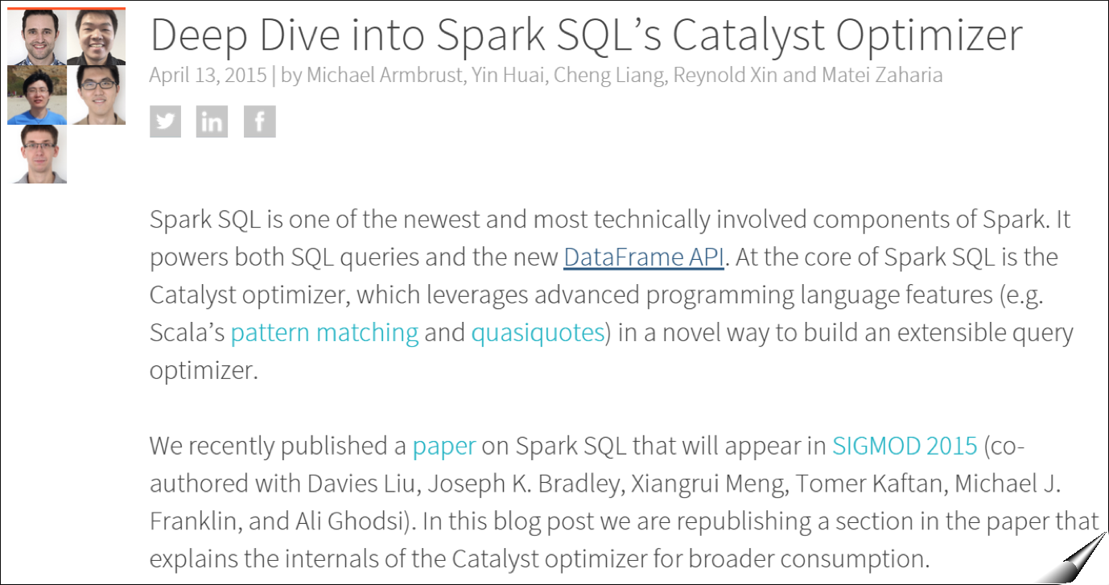
Catalyst Internals
https://databricks.com/blog/2015/04/13/deep-dive-into-spark-sqls-catalyst-optimizer.html
Notes:
https://databricks.com/blog/2015/04/13/deep-dive-into-spark-sqls-catalyst-optimizer.html

Slide 129
DataFrame limitations
Catalyst does not automatically repartition DataFrames optimally
During a DF shuffle, Spark SQL will just use
spark.sql.shuffle.partitions
to determine the number of partitions in the downstream RDD
All SQL configurations can be changed
via sqlContext.setConf(key, value)
or in Databricks: "%sql SET key=val"
Notes:
Can you also please repeat what are the ~3 fundamental transformations that you use when processing the DAG of DFs?“
Note that Spark conf can't be altered, but sql config can.

Slide 130
Machine Learning Integration
Spark 1.2 introduced a new package called spark.ml, which aims to provide a uniform set of high-level APIs that help users create and tune practical machine learning pipelines.
Spark ML standardizes APIs for machine learning algorithms to make it easier to combine multiple algorithms into a single pipeline, or workflow.

Slide 131
Machine Learning Integration
Spark ML uses DataFrames as a dataset which can hold a variety of data types.
For instance, a dataset could have different columns storing text, feature vectors, true labels, and predictions.

Slide 132
More hands-on with DataFrames
In the Databricks shard, look in
Workspace > Labs > sql-and-dataframes
In there, you'll find a lab01 folder, with Python and Scala folders beneath it.
Open the notebook underneath the cloned folder
Attach the notebook to your cluster
Follow the instructions in the notebook
If you have problems with any of the exercises, consult the Solutions notebook in the cloned folder.

Slide 133
End of DataFrames and Spark SQL

Slide 134

App ➔ Jobs ➔ Stages ➔ Tasks
?

Slide 135

“The key to tuning Spark apps is a sound grasp of Spark’s internal mechanisms”
- Patrick Wendell, Databricks Founder, Spark Committer, Spark PMC

Slide 136
Terminology
Job: The work required to compute an RDD
Stage: A wave of work within a job, corresponding to one or more pipelined RDD’s
Tasks: A unit of work within a stage, corresponding to one RDD partition
Shuffle: The transfer of data between stages

Slide 137
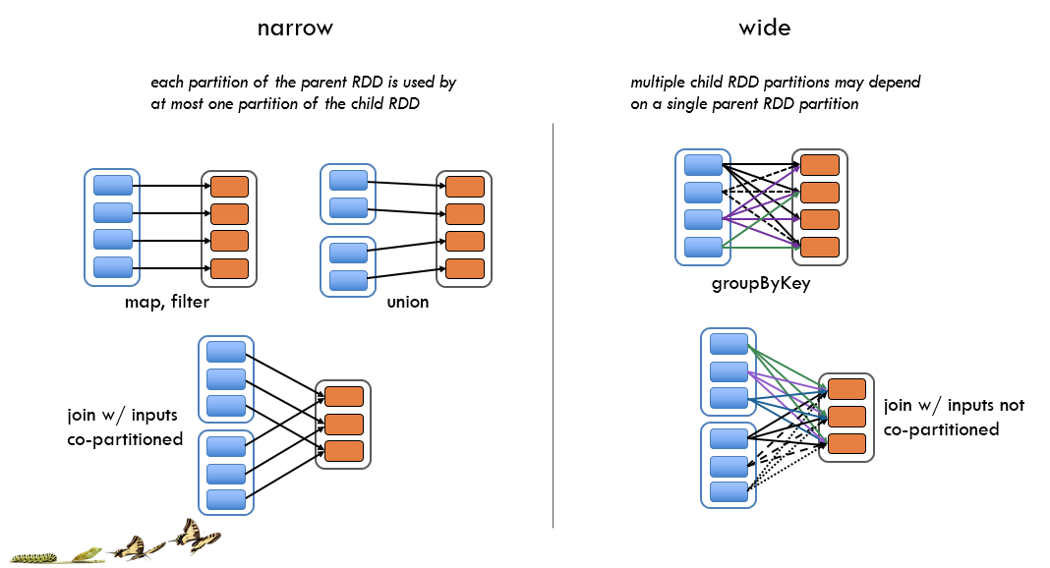
Narrow vs. Wide Dependencies
Notes:
The DAG Scheduler only understands narrow vs. wide dependencies… so shuffle stage boundaries…
The DAG Scheduler splits the graph into multiple stages. Stage boundaries are wide dependencies (so operations that you cannot pipeline).

Slide 138
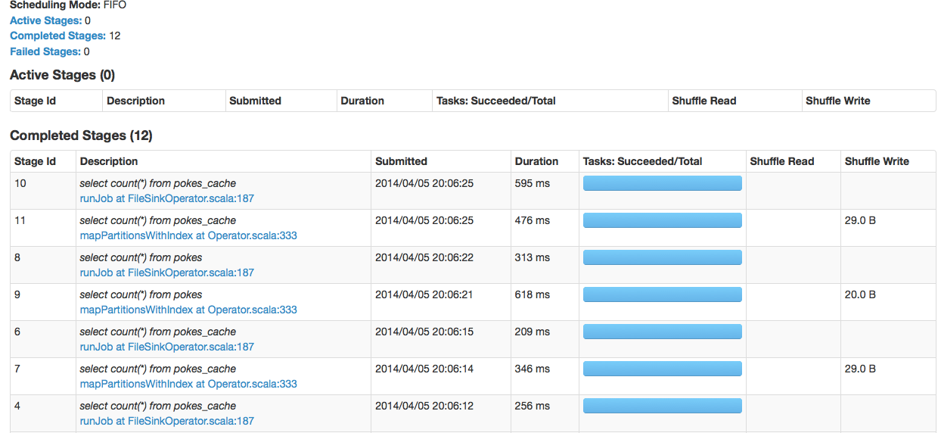
Planning Physical Execution
How does a user program get translated into units of physical execution?
application >> jobs >> stages >> tasks
?
Notes:
One thing users ask us a lot is “If I wrote Spark program, it’ll compile down to some execution terminology like stages and tasks but how does that execution stuff that I see in the Spark UI get derived from the application code that I wrote?”
So answering this will be our big focus for the next 30 minutes.

Slide 139
Scheduling Process
Spark Application
…
Kicked off by Action
Job
Job
Stages
Stages
Stages
Stages
Time
Stages
Notes:
Q) Does every Action in Spark result in exactly one Job being run in the execution environment?
No.
Q) Can a Action sometimes result in multiple Jobs being run? When? Why? Is this determined by the complexity of the DAG above the RDD on which I called Action or something else?
Yes. For example, take can fire multiple jobs. It tries to fetch data from the 1st partition with a job, and if it doesn't have enough data, it fetches from more partitions.

Slide 140

Scheduling Process
RDD Objects
DAG Scheduler
Task Scheduler
Executor
TaskSet
Task
DAG
Task Scheduler
Task threads
Block manager
Rdd1.join(rdd2)
.groupBy(…)
.filter(…)
Split graph into stages of tasks
Submit each stage as ready
Launches individual tasks
Retry failed or straggling tasks
Execute tasks
Store and serve blocks
- Build operator DAG
Notes:
Q) Does every Action in Spark result in exactly one Job being run in the execution environment?
No.
Q) Can a Action sometimes result in multiple Jobs being run? When? Why? Is this determined by the complexity of the DAG above the RDD on which I called Action or something else?
Yes. For example, take can fire multiple jobs. It tries to fetch data from the 1st partition with a job, and if it doesn't have enough data, it fetches from more partitions.
Q) On a different note, inside of a job, is it true that sometimes stages run in serial, one after another... and other times 2 stages can run in parallel?
Yes. For example a join. The two input stages can run in parallel.
Jobs: Work required to compute RDD in runJob.
Stages: A wave of work within a job, corresponding to one or more pipelined RDD’s.
Tasks: A unit of work within a stage, corresponding to one RDD partition.
Shuffle: The transfer of data between stages.
A stage corresponds to a collection oftasks that all execute the same code, each on a different subset of the data. Each stage contains a sequence of transformations that can be completed without shuffling the full data.
The set of stages produced for a particular action is termed a job . In each case when we invoke actions such as count , we are creating a job composed of one or more stages.
Once the stage graph is defined, tasks are created and dispatched to an internal scheduler
which varies depending on the deployment mode being used. Stages in the physical plan
can depend on each other, based on the RDD lineage, so they will be executed in a
specific order. For instance a stage that outputs shuffle data most occur before one that
relies on that data being present.

Slide 141

RDD API Example
INFO Server started
INFO Bound to port 8080
WARN Cannot find srv.conf
// Read input file
val input = sc.textFile("input.txt")
val tokenized = input
.map(line => line.split(" "))
.filter(words => words.size > 0) // remove empty lines
val counts = tokenized // frequency of log levels
.map(words => (words(0), 1))
.reduceByKey( (a, b) => a + b, 2 )
input.txt
Notes:
This program will become the basis of our next slides.
There’s an input file that has a bunch of log messages with level of severity and a message. Notice that the 3rd line is empty.
sc.textFile() is a way to read via the Hadoop input format. So this could be a big file in HDFS or S3.
Goal: We want to do a count for each of the different types of severity levels. So how many INFO vs WARN?
First tokenize the RDD that splits each entry into individual words, then does a filter (so if there’s an empty line, we get rid of it).
Then we make an RDD called counts that takes the tokenized RDD and runs map again to emit a count of 1 for each first element, then reduceByKey b/c we now have a key/value RDD and we want to add up each of the corresponding counts. Globally this will do a reduce for exactly how many total INFO or WARNs there are.
So the question now is “How does Spark interpret this?” “What is the underlying execution engine do with this? And how is this viewed in terms of the internal details of Spark?”
So to show that, I’m going to do a few things. First, *click*

Slide 142
RDD API Example
// Read input file
val input = sc.textFile( )
val tokenized = input
.map( )
.filter( ) // remove empty lines
val counts = tokenized // frequency of log levels
.map( )
.reduceByKey{ }
Notes:
I’m going to take out all of the specific arguments (the actual functions that were passed) b/c they don’t have to do with the logical structure of the program.
From Spark’s perspective, those details are not fundamental to the way the program is compiled.
So, we just erased a bunch of function arguments.
Next, let’s re-write this as a single chained function of calls.

Slide 143
Transformations
sc.textFile().map().filter().map().reduceByKey()
Notes:
This is a single chained set of calls.
In the original program, we created some intermediate variables and called functions of them. But in reality, to Spark every one of the transformation calls is a pointer to the parent RDD that it was transformed from… so it really is just a single series of relationships being created (that’s sometimes called a DAG)

Slide 144
DAG View of RDDs
textFile() map() filter() map() reduceByKey()
Hadoop RDD
Mapped RDD
Filtered RDD
Mapped RDD
Shuffle RDD
Partition 1
Partition 1
Partition 1
Partition 1
Partition 1
Partition 2
Partition 2
Partition 2
Partition 2
Partition 2
Partition 3
Partition 3
Partition 3
Partition 3
input
tokenized
counts
Notes:
Now, let’s draw out the individual RDDs that are being created.

Slide 145
Evaluation of the DAG
DAGs are materialized through a method sc.runJob:
def runJob[T, U](
rdd: RDD[T], 1. RDD to compute
partitions: Seq[Int], 2. Which partitions
func: (Iterator[T]) => U)) 3. Fn to produce results
: Array[U] → results for each partition

Slide 146
How runJob Works
Needs to compute target’s parents, parents’ parents, etc. … all the way back to an RDD with no dependencies (e.g., HadoopRDD)
runJob(counts)
Hadoop RDD
Mapped RDD
Filtered RDD
Mapped RDD
Shuffle RDD
Partition 1
Partition 1
Partition 1
Partition 1
Partition 1
Partition 2
Partition 2
Partition 2
Partition 2
Partition 2
Partition 3
Partition 3
Partition 3
Partition 3
input
tokenized
counts
Notes:
Physical optimizations
1) Certain types of transformations can be pipelined.
2) If dependent RDD’s have already been cached (or persisted in a shuffle) the graph can be truncated.
Once pipelining and truncation occur, Spark produces a set of stages each stage is composed of tasks

Slide 147
How runJob Works
Needs to compute target’s parents, parents’ parents, etc. … all the way back to an RDD with no dependencies (e.g., HadoopRDD)
runJob(counts)
Hadoop RDD
Mapped RDD
Filtered RDD
Mapped RDD
Shuffle RDD
Partition 1
Partition 1
Partition 1
Partition 1
Partition 1
Partition 2
Partition 2
Partition 2
Partition 2
Partition 2
Partition 3
Partition 3
Partition 3
Partition 3
input
tokenized
counts
Notes:
Physical optimizations
1) Certain types of transformations can be pipelined.
2) If dependent RDD’s have already been cached (or persisted in a shuffle) the graph can be truncated.
Once pipelining and truncation occur, Spark produces a set of stages each stage is composed of tasks

Slide 148
Stage Graph
Each task will:
Read Hadoop input
Perform maps & filters
Write partial sums
Pipelined Stage 1
Stage 2
Each task will:
Read partial sums
Invoke user function passed to runJob
Partition 1
Partition 1
Partition 2
Partition 2
Partition 3
Shuffle read
Input read
Shuffle write

Slide 149
End of Spark DAG

Slide 150

Spark Streaming
TwitterUtils.createStream(...) .filter(_.getText.contains("Spark")) .countByWindow(Seconds(5))
Notes:
Spark Streaming can handing gigabytes of data per second
Note that Python API was added starting Spark 1.2 (it supports all DSTream transformations and almost all output operations). But it currently only supports basic incoming sources like text files and text data over network sockets (Flume + Kafka support in PySpark coming soon)

Slide 151

Spark Streaming
Scalable
High-throughput
Fault-tolerant
TCP socket
Kafka
HDFS / S3
Flume
Cassandra
HBase
HDFS
Dashboards
S3
Streaming
Databases
Kinesis
Complex algorithms can be expressed using:
Spark transformations: map(), reduce(), join()…
MLlib + GraphX
SQL
Twitter
Notes:
Spark Streaming is an extension of the core Spark API that enables scalable, high-throughput, fault-tolerant stream processing of live data streams.
Data can be ingested from many sources like Kafka, Flume, Twitter, ZeroMQ, Kinesis or TCP sockets can be processed using complex algorithms expressed with high-level functions like map,reduce, join and window.
Finally, processed data can be pushed out to filesystems, databases, and live dashboards.
In fact, you can apply Spark’s machine learning (3 work right now, Streaming K-Means, Logistic regression, linear regression) and graph processing algorithms on data streams.

Slide 152

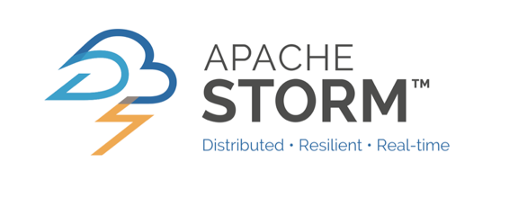
Batch and Real-time
Batch
Real-time
Streaming
One unified API

Slide 153


Use Cases
Streaming
Page views
Kafka for buffering
Spark for processing

Slide 154
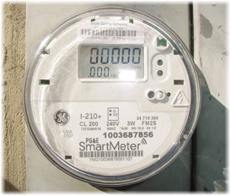


Use Cases
Smart meter readings
Join 2 live data sources
Streaming
Live weather data
Notes:
An electric company can join 100s of thousands of live data points from the electric grid with live weather data and apply predictive machine learning algorithms to try to predict that a snow storm might be starting in Denver and to start devoting personnel and resources there to fix grid problems.

Slide 155
Data Model
Input data streams
Batches of processed data
Streaming
R
R
CORE
R
Batches every X seconds

Slide 156

DStream (Discretized Stream)
Batch interval = 5 seconds
T = 5
Input
DStream
Part. #1
Part. #2
Part. #3
RDD @ T=5
One RDD is created every 5 seconds
Notes:
TO-DO: animate the second one after first.
Spark is built on the idea of RDDs. Likewise, Spark Streaming is build on the idea of Dstreams.
A DStream is a sequence of data arriving over time.
Internally, each DStream is represented as a sequence of RDDs arriving at each time step.
Each RDD in a DStream contains data from a certain interval, as shown in the following figure.

Slide 157
DStream (Discretized Stream)
Batch interval = 5 seconds
T = 5
T = 10
Input
DStream
Part. #1
Part. #2
Part. #3
Part. #1
Part. #2
Part. #3
RDD @ T=5
RDD @ T=10
One RDD is created every 5 seconds
Notes:
TO-DO: animate the second one after first.
Spark is built on the idea of RDDs. Likewise, Spark Streaming is build on the idea of Dstreams.
A DStream is a sequence of data arriving over time.
Internally, each DStream is represented as a sequence of RDDs arriving at each time step.
Each RDD in a DStream contains data from a certain interval, as shown in the following figure.

Slide 158


Transforming DStreams
5 sec
10 sec
15 sec
Block #1
Block #2
Block #3
Notes:
Ask TD: Is that first conversion from Blocks to Partitions called a transformation?
Any operation applied on a DStream translates to operations on the underlying RDDs.
These underlying RDD transformations are computed by the Spark engine. The DStream operations hide most of these details and provide the developer with higher-level API for convenience.

Slide 159
Transforming DStreams
5 sec
10 sec
15 sec
Block #1
Block #2
Block #3
linesDStream
Part. #1
Part. #2
Part. #3
Notes:
Ask TD: Is that first conversion from Blocks to Partitions called a transformation?
Any operation applied on a DStream translates to operations on the underlying RDDs.
These underlying RDD transformations are computed by the Spark engine. The DStream operations hide most of these details and provide the developer with higher-level API for convenience.

Slide 160
Transforming DStreams
5 sec
10 sec
15 sec
Block #1
Block #2
Block #3
linesDStream
Part. #1
Part. #2
Part. #3
flatMap()
wordsDStream
Part. #1
Part. #2
Part. #3
Notes:
Ask TD: Is that first conversion from Blocks to Partitions called a transformation?
Any operation applied on a DStream translates to operations on the underlying RDDs.
These underlying RDD transformations are computed by the Spark engine. The DStream operations hide most of these details and provide the developer with higher-level API for convenience.

Slide 161


Scala Example
import org.apache.spark.streaming._
val sc = SparkContext(...)
// Create a StreamingContext with a 1-second batch size from a SparkConf
val ssc = new StreamingContext(sc, Seconds(1))
// Create DStream using data received after connecting to localhost:7777
val linesStream = ssc.socketTextStream("localhost", 7777)
// Filter our DStream for lines with "error"
val errorLinesStream = linesStream.filter {_ contains "error"}
// Print out the lines with errors
errorLinesStream.pprint()
// Start our streaming context and wait for it to "finish"
ssc.start()
ssc.awaitTermination()
linesStream
errorLinesStream
Notes:
In code, it’s all Stream types… but in the background… in execution layer, it is making RDDs.
First, we import StreamingContext, which is the main entry point for all streaming functionality. We create a local StreamingContext with two execution threads, and batch interval of 5 seconds.
Using this context, we can create a DStream that represents streaming data from a TCP source, specified as hostname (e.g. localhost) and port (e.g. 9999).
This lines DStream represents the stream of data that will be received from the data server. Each record in this DStream is a line of text. Next, we want to split the lines by space into words.
flatMap is a one-to-many DStream operation that creates a new DStream by generating multiple new records from each record in the source DStream. In this case, each line will be split into multiple words and the stream of words is represented as the words DStream. Next, we want to count these words.
The words DStream is further mapped (one-to-one transformation) to a DStream of (word, 1) pairs, which is then reduced to get the frequency of words in each batch of data. Finally, wordCounts.pprint() will print a few of the counts generated every second.
Start receiving data and processing it using streamingContext.start()
Wait for the processing to be stopped (manually or due to any error) usingstreamingContext.awaitTermination()
The processing can be manually stopped using streamingContext.stop().

Slide 162

Example
Terminal
#1
Terminal
#2
$ nc –l –p 7777
all is good
there was an error
good good
error 4 happened
all good now
$ spark-submit --class com.examples.Scala.StreamingLog \
$ASSEMBLY_JAR local[4]
. . .
--------------------------
Time: 2015-05-26 15:25:21
--------------------------
there was an error
--------------------------
Time: 2015-05-26 15:25:22
--------------------------
error 4 happened

Slide 163
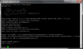
Example
Batch interval = 600 ms
localhost 7777
W
Ex
RDD, P1
T
R
W
RDD, P2
T
T
block, P1
T
T
Ex
RDD, P3
T
T
Internal Threads
RDD, P4
T
T
block, P1
T
T
Driver
Internal Threads
Notes:
Most input Dstream (except file stream or 1.3 Kafka direct stream) are associated with a Receiver object which receives the data from a source
Note that, unlike RDDs, the default persistence level of DStreams keeps the data serialized in memory.
From the block, the partition can spill to disk if needed
The 2nd Executor for replication is chosen randomly
Block Interval: 200 ms

Slide 164
Example
Batch interval = 600 ms
W
W
Ex
Ex
RDD, P1
T
R
W
block, P2
T
T
RDD, P2
T
T
block, P1
Ex
T
T
T
T
block, P2
T
T
T
T
RDD, P3
Internal Threads
RDD, P4
T
T
block, P1
T
T
Internal Threads
Driver
Internal Threads
200 ms later

Slide 165
Example
Batch interval = 600 ms
W
W
Ex
Ex
RDD, P1
T
R
W
block, P2
T
T
RDD, P2
T
T
block, P1
Ex
T
T
T
T
block, P2
T
T
T
T
block, P3
RDD, P3
Internal Threads
RDD, P4
T
T
block, P1
T
T
Internal Threads
block, P3
Driver
Internal Threads
200 ms later

Slide 166
Example
Batch interval = 600 ms
W
W
Ex
Ex
RDD, P1
T
R
W
RDD, P2
T
T
RDD, P2
T
T
RDD, P1
Ex
T
T
T
T
RDD, P2
T
T
T
T
RDD, P3
RDD, P3
Internal Threads
RDD, P4
T
T
RDD, P1
T
T
Internal Threads
RDD, P3
Driver
Internal Threads
Notes:
In addition to using a garbage collector less likely to introduce pauses, you can make a
big difference by reducing GC pressure. Caching RDDs in serialized form (instead of
as native objects) also reduces GC pressure, which is why, by default, RDDs generated
by Spark Streaming are stored in serialized form. Using Kryo serialization further re‐
duces the memory required for the in memory representation of cached data.

Slide 167
Example
Batch interval = 600 ms
W
W
Ex
Ex
RDD, P1
T
R
W
RDD, P2
T
T
RDD, P2
T
T
RDD, P1
Ex
T
T
T
T
RDD, P2
T
T
T
T
RDD, P3
RDD, P3
Internal Threads
RDD, P4
T
T
RDD, P1
T
T
Internal Threads
RDD, P3
Driver
Internal Threads
OS Disk
SSD
SSD
OS Disk
SSD
SSD
OS Disk
SSD
SSD
Notes:
To-do: is it correct to color the SSD disks from purple to blue?
From the block, the partition can spill to disk if needed
The 2nd Executor for replication is chosen randomly
Show spilling on window operations.. Not really here.

Slide 168
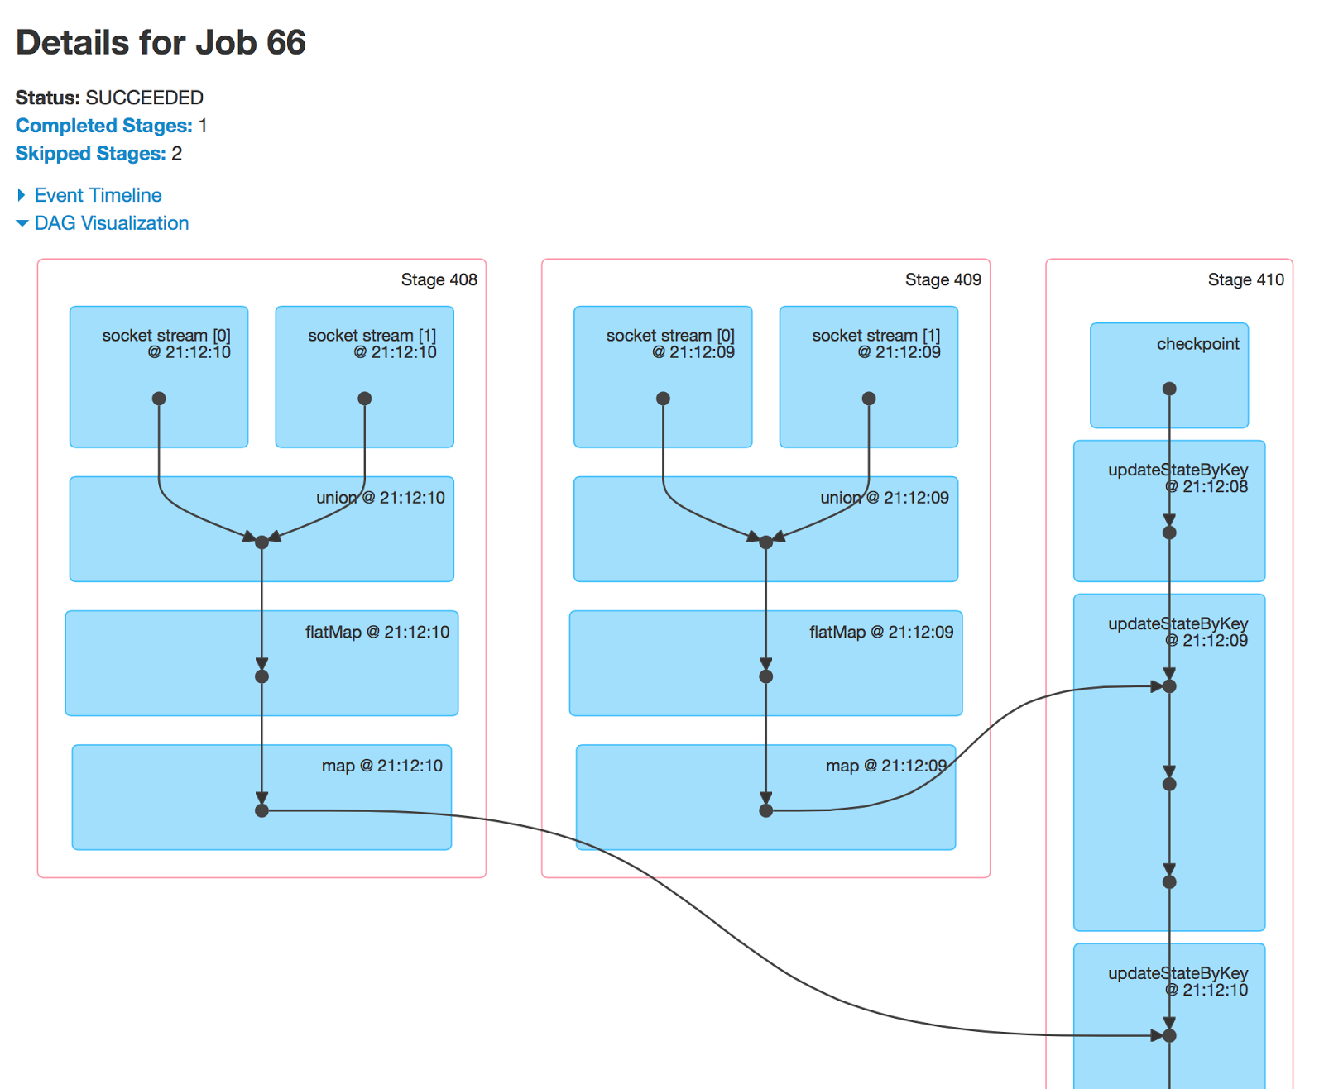

Streaming Viz
1.4.0
Notes:
These show DStream operations now like updateStateByKey
This also shows the batch time (# after @)
batch times can be milliseconds, if they’re running more often than, say, every second
408 is a batch, 409 is different batch (that happened before, stage name is kinda inverted in Streaming)

Slide 169
2 Input DStreams
Batch interval = 600 ms
W
W
Ex
Ex
T
R
R
W
block, P1
T
T
T
block, P1
Ex
T
T
T
T
T
T
T
T
Internal Threads
T
T
block, P1
T
T
Internal Threads
block, P1
Driver
Internal Threads
OS Disk
SSD
SSD
OS Disk
SSD
SSD
OS Disk
SSD
SSD
Notes:
Note that Spark worker/executor as a long-running task, hence it occupies one of the cores allocated to the Spark Streaming application. Hence, it is important to remember that Spark Streaming application needs to be allocated enough cores (or threads, if running locally) to process the received data, as well as, to run the receiver(s).
When running a Spark Streaming program locally, do not use “local” or “local[1]” as the master URL. Either of these means that only one thread will be used for running tasks locally. If you are using a input DStream based on a receiver (e.g. sockets, Kafka, Flume, etc.), then the single thread will be used to run the receiver, leaving no thread for processing the received data.

Slide 170
2 Input DStreams
Batch interval = 600 ms
W
W
Ex
Ex
block, P3
T
R
R
block, P3
W
block, P1
T
T
T
block, P1
Ex
block, P2
T
T
T
T
block, P2
block, P2
T
T
block, P3
T
T
block, P2
block, P3
Internal Threads
T
T
block, P1
T
T
Internal Threads
block, P1
Driver
Internal Threads

Slide 171
2 Input DStreams
Batch interval = 600 ms
Materialize!
W
W
Ex
Ex
RDD, P3
T
R
R
RDD, P3
W
RDD, P1
T
T
T
RDD, P1
Ex
RDD, P2
T
T
T
T
RDD, P2
RDD, P2
T
T
RDD, P3
T
T
RDD, P2
RDD, P3
Internal Threads
T
T
RDD, P1
T
T
Internal Threads
RDD, P1
Driver
Internal Threads

Slide 172
2 Input DStreams
Batch interval = 600 ms
Union!
W
W
Ex
Ex
RDD, P1
T
R
R
RDD, P2
W
RDD, P3
T
T
T
RDD, P3
Ex
RDD, P4
T
T
T
T
RDD, P5
RDD, P5
RDD, P1
T
T
T
T
RDD, P6
Internal Threads
RDD, P2
T
T
RDD, P4
T
T
Internal Threads
RDD, P6
Driver
Internal Threads

Slide 173
DStream-Dstream Unions
Stream–stream Union
val numStreams = 5
val kafkaStreams = (1 to numStreams).map { i => KafkaUtils.createStream(...) }
val unifiedStream = streamingContext.union(kafkaStreams)
unifiedStream.print()
Notes:
In f

Slide 174
DStream-Dstream Joins
Stream–stream Join
val stream1: DStream[String, String] = ...
val stream2: DStream[String, String] = ...
val joinedStream = stream1.join(stream2)
Notes:
In f

Slide 175

Transformations on DStreams
λ
map( )
λ
reduce( )
union(otherStream)
λ
updateStateByKey( )
λ
flatMap( )
λ
filter( )
join(otherStream,[numTasks])
cogroup(otherStream,[numTasks])
RDD
repartition(numPartitions)
λ
transform( )
count()
λ
RDD
reduceByKey( ,[numTasks])
countByValue()
Notes:
Transform: Return a new DStream by applying a RDD-to-RDD function to every RDD of the source DStream. This can be used to do arbitrary RDD operations on the DStream

Slide 176
More hands-on with Streaming
In the Databricks shard, look in
Workspace > Labs > streaming
In there, you'll find a Wikipedia-Anonymous-Edits folder, with an Anonymous-Edits Scala notebook and a Solutions notebook beneath it.
Clone Wikipedia-Anonymous-Edits folder to your home folder
Open the Anonymous-Edits notebook underneath the cloned folder
Attach the notebook to your cluster
Follow the instructions in the notebook
If you have problems with any of the exercises, consult the Solutions notebook in the cloned folder.

Slide 177
End of Spark Streaming

Slide 178
Spark Machine Learning

Slide 179
Example: Log prioritization
Data: Test logs
Goal: Prioritize logs to investigate
Running test: pyspark/conf.py
Spark assembly has been built with Hive, including Datanucleus jars on classpath
14/12/15 18:36:12 WARN Utils: Your hostname,
-1.1
Running test: pyspark/broadcast.py
Spark assembly has been built with Hive, including Datanucleus jars on classpath
14/12/15 18:36:30 ERROR Aliens attacked the
1.9
Notes:
We will use a log prioritization example. This is an application of machine learning. (not an algo)
Goal, take test logs… and predict a priority.
Priority will tell us which logs we need to investigate further.
Here, see normal test, it worked, don’t need to look at it.
2nd has a higher priority (error)
But you can’t look at every log line, so this is a way to find the important logs

Slide 180
Example: Log prioritization
Data: Test logs
Goal: Prioritize logs to investigate
Instance
Running test: pyspark/conf.py
Spark assembly has been built with Hive, including Datanucleus jars on classpath
14/12/15 18:36:12 WARN Utils: Your hostname,
Label
-1.1
How can we learn?
Choose a model
Get training data
Run a learning algorithm
Notes:
Here, just to define somer terminology
Left: Instance text. The datam
We want to predict the label (the priority here, but it could be many things). It could be spam or not spam for an email. It could be temp for that date.
How can we learn? There’s 3 parts: choose a model, get data, run an algorithm to fit that model on the data.

Slide 181
A model is a function f: x → y
(prediction)
Instance
x
Running test: pyspark/conf.py
Spark assembly has been built with Hive, including Datanucleus jars on classpath
14/12/15 18:36:12 WARN Utils: Your hostname,
y
Label
-1.1
Convert to features,
e.g., word counts
...
Running
test
Spark
aliens
43
67
110
0
Feature vector x
mllib.linalg.Vector
Notes:
Mathematically speaking, a model is a function going from x to y.
X is instance, y is label (priority)
The way you represent this function on a computer is by first taking the instance and converting it to a numerical vector, called a feature vector (like word count)
Here, there’s 43 instances of the word running, 67 of test, etc.
In Mllib, this will be represented by a linalg.Vector. Throughout this talk, I’ll try to put these classes to look for in green just to make it easier ot look up.
There is a class in Mllib that does this (converts words to feature vector), called a feature transformer.
This vector is a object.

Slide 182
A model is a function f: x → y
LinearRegression
Learning
= choosing parameters w
Our model: Parameter vector w
...
w:
0.0
0.1
-0.1
50
...
y
w^{T}x
0.0
+
6.7
+
-11.0
+
0.0
= -1.1
Running
test
Spark
aliens
...
x:
43
67
110
0
Notes:
The model is a function.
One the data is represented as a feature vector, what odes the model look like… mathematically?
This is an example with linear regression, one of the most common ML models.
The model is just another vector called a parameter vector.
Give, this model…The way that you compute a prediction, is a simple vector dot product.
The word running has a corresponding weight in the model vector. Here the weight is zero indicating that the appearance of the word running does not affect log priority. -11 means, it is pushing the priority even lower.
So each of the #s in the middle is the word count times it’s corresponding weight. And then we add them all together, and that’s the prediction (y)
So, learning means choosing these parameters w.

Slide 183
Data for learning
Instance
Running test: pyspark/conf.py
Spark assembly has been built with Hive, including Datanucleus jars on classpath
14/12/15 18:36:12 WARN Utils: Your hostname,
Label
-1.1
LabeledPoint(features: Vector, label: Double)

Slide 184
Data for learning
Instances
Labels
Running test: pyspark/conf.py
Spark assembly has been built with Hive, including Datanucleus jars on classpath
14/12/15 18:36:12 WARN Utils: Your hostname,
-1.1
Dataset
RDD[LabeledPoint]
Running test: pyspark/conf.py
Spark assembly has been built with Hive, including Datanucleus jars on classpath
14/12/15 18:36:12 WARN Utils: Your hostname,
2.3
Running test: pyspark/conf.py
Spark assembly has been built with Hive, including Datanucleus jars on classpath
14/12/15 18:36:12 WARN Utils: Your hostname,
0.1
...

Slide 185
ML algorithms
Recall:
A model is a function: features → label
LinearRegressionModel.predict(features: Vector): Double
A training dataset is a set of (features, label) pairs
RDD[LabeledPoint]
An ML algorithm is a function: dataset → model
LinearRegression.train(
data: RDD[LabeledPoint]): LinearRegressionModel
Notes:
Here we talk about how basic ML workflow works in 2 phrases: training and testing.
Training: takes a Dataset and a ML algo (like linear regressison) and we get a ML model (here a linear regression model)
In the testing phase, you pick new logs and notice that this time there are no labels. Apply the ML model, which can look at each log and predict a priority.

Slide 186
Workflow: training + testing
New API
(“Pipelines”)
Dataframe
Running test: pyspark/conf.py
Spark assembly has been built with Hive, including Datanucleus jars on classpath
14/12/15 18:36:12 WARN Utils: Your hostname,
-1.1
Estimator
ML model
Running test: pyspark/conf.py
Spark assembly has been built with Hive, including Datanucleus jars on classpath
14/12/15 18:36:12 WARN Utils: Your hostname,
2.3
ML algorithm
Linear
Regression
Model
Training
Running test: pyspark/conf.py
Spark assembly has been built with Hive, including Datanucleus jars on classpath
14/12/15 18:36:12 WARN Utils: Your hostname,
0.1
Linear
Regression
Running test: pyspark/conf.py
Spark assembly has been built with Hive, including Datanucleus jars on classpath
14/12/15 18:36:12 WARN Utils: Your hostname,
-1.1
…
Transformer
New logs
Predicted priorities
ML model
Running test: pyspark/conf.py
Spark assembly has been built with Hive, including Datanucleus jars on classpath
14/12/15 18:36:12 WARN Utils: Your hostname,
-1.1
Testing
Running test: pyspark/conf.py
Spark assembly has been built with Hive, including Datanucleus jars on classpath
14/12/15 18:36:12 WARN Utils: Your hostname,
2.3
Running test: pyspark/conf.py
Spark assembly has been built with Hive, including Datanucleus jars on classpath
14/12/15 18:36:12 WARN Utils: Your hostname,
0.1
…
Notes:
The word pipeline refers to workflow and basically you pipe data through a series of transformations.

Slide 187
+ Evaluation
New API
(“Pipelines”)
Training
Estimator
Model
(Transformer)
Training data
Testing
Transformer
Test data
Predicted priorities
Evaluator
Predicted labels +
true labels (on test data)
Metric (MSE)
Evaluation
RDD[(Double, Double)]
Regression
Metrics
Double
How good is the model?
Model selection
Choose among different models
or model hyperparameters
Notes:
These are the same things (training and testing) just compressed.
But really, there’s also a 3rd part, which is evaluation. In Evaluation, you take predicted priorities (or labels) as well as true labels on new data, which the algorithm did not see and compute this metric.
You predict priorities on new data and then compare these with the true labels and compute a metric to see how well you did.
How much data do you hold back? Depends on data. If huge dataset, then maybe 5%, but if a small dataset, then hold back maybe 1/3 of the data.
MSE: Means Squared Error: this is applicable to linear regression or any regression where prediction – true label squared and then you average this across the dataset.

Slide 188
Summary: ML Overview
Components
Dataset
Model
Algorithm
Processes
Training – Test – Evaluation
Model selection

Slide 189
About Spark MLlib
SparkSQL
Streaming
MLlib
GraphX
Started at Berkeley AMPLab
(Spark 0.8)
Now (Spark 1.6)
Contributions from 75+ orgs, ~250 individuals
Development driven by Databricks: roadmap + 50% of PRs
Growing coverage of distributed algorithms
Spark
Notes:
Contributions estimated from github commit logs, with some effort to de-duplicate entities.

Slide 190
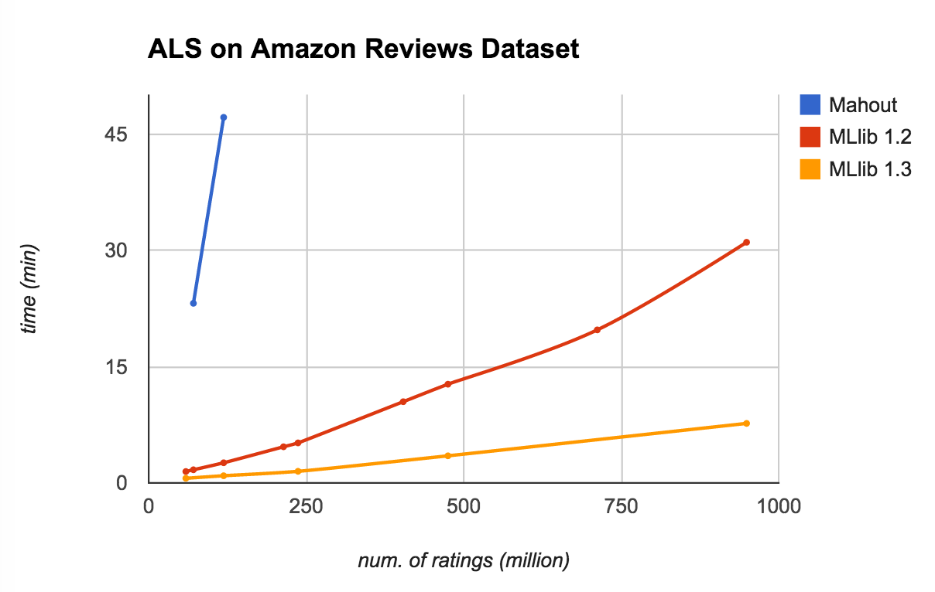
Scalability: Recommendation using ALS
Amazon Reviews: ~6.6 million users, ~2.2 million items, and ~30 million ratings
Tested ALS on stacked copies on a 16-node m3.2xlarge cluster with rank=10, iter=10

Slide 191
Recommendation with Spotify Dataset
50 million users, 5 million songs, and 50 billion ratings
Time: ~1 hour (10 iterations with rank 10)
Total cost: $10 (32 nodes with spot instances for 1 hour)
Thanks to Chris Johnson and Anders Arpteg @ Spotify for data.

Slide 192
Algorithm Coverage
Classification
Regression
Recommendation
Clustering
Frequent itemsets
Feature extraction & selection
Statistics
Linear algebra
Model import/export
Pipelines
DataFrames
Cross validation

Slide 193
Classification
Logistic regression & linear SVMs
L1, L2, or elastic net regularization
Decision trees
Random forests
Gradient-boosted trees
Naive Bayes
Multilayer perceptron
One-vs-rest
Streaming logistic regression
Regression
Least squares
L1, L2, or elastic net regularization
Decision trees
Random forests
Gradient-boosted trees
Isotonic regression
Streaming least squares
based on Spark 1.5

Slide 194
Feature extraction, transformation & selection
Binarizer
Bucketizer
Chi-Squared selection
CountVectorizer
Discrete cosine transform
ElementwiseProduct
Hashing term frequency
Inverse document frequency
MinMaxScaler
Ngram
Normalizer
VectorAssembler
VectorIndexer
VectorSlicer
Word2Vec
Normalizer
One-Hot Encoder
PCA
PolynomialExpansion
RFormula
SQLTransformer
Standard scaler
StopWordsRemover
StringIndexer
Tokenizer
StringIndexer
DataFrames
Similar to R & pandas
Many built-in functions: math, stats, NaN support
based on Spark 1.5

Slide 195
Clustering
Gaussian mixture models
K-Means
Streaming K-Means
Latent Dirichlet Allocation
Power Iteration Clustering
Recommendation
Alternating Least Squares (ALS)
Frequent itemsets
FP-growth
Prefix span
Statistics
Pearson correlation
Spearman correlation
Online summarization
Chi-squared test
Kernel density estimation
Linear Algebra
Local & distributed dense & sparse matrices
Matrix decompositions (PCA, SVD, QR)
based on Spark 1.5

Slide 196
Ongoing Efforts
ML Pipelines
DataFrames
Spark R

Slide 197
ML Pipelines
Load data
Extract features
Train model
Evaluate

Slide 198
ML Pipelines
Datasource 2
Datasource 1
Datasource 3
Train model 1
Extract features
Extract features
Train model 2
Feature transform 1
Ensemble
Feature transform 2
Evaluate
Feature transform 3

Slide 199
ML Pipelines
Simple construction, tuning, and testing for ML workflows
ML Pipelines provide:
Familiar API based on scikit-learn
Integration with DataFrames
Simple parameter tuning
User-defined components

Slide 200
Hands-on with Machine Learning
In the Databricks shard, look in
Essentials > Machine Learning
In there, you'll find a new-python folder.
Clone the Python folder to your home folder
Open the lab notebook underneath the cloned folder
Attach the notebook to your cluster
Follow the instructions in the notebook
If you have problems with any of the exercises, consult the Solutions notebook in the cloned folder.

Slide 201
Hands-on with Machine Learning
But, before that:
TODO: Feedback form

Slide 202
End of Spark Machine Learning

Slide 203
Additional Resources
Books
Learning Spark. http://shop.oreilly.com/product/0636920028512.do
Advanced Analytics with Spark. http://shop.oreilly.com/product/0636920035091.do
Scala for the Impatient. http://www.informit.com/store/scala-for-the-impatient-9780321774095
Web Sites
Spark documentation: http://spark.apache.org/docs/latest/
Databricks blog: https://databricks.com/blog

Slide 204
Thank you.

